Slide 1
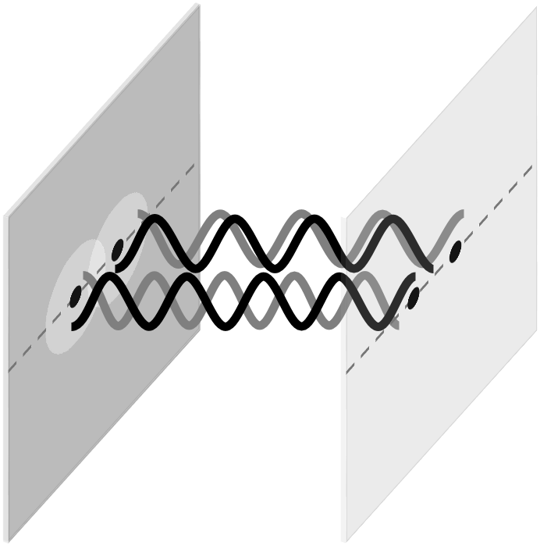
OPTICS f2f p 127

Slide 2
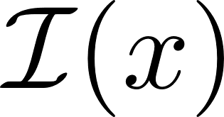
Fringe visibility is a measure of coherence
OPTICS f2f p 128

Slide 3
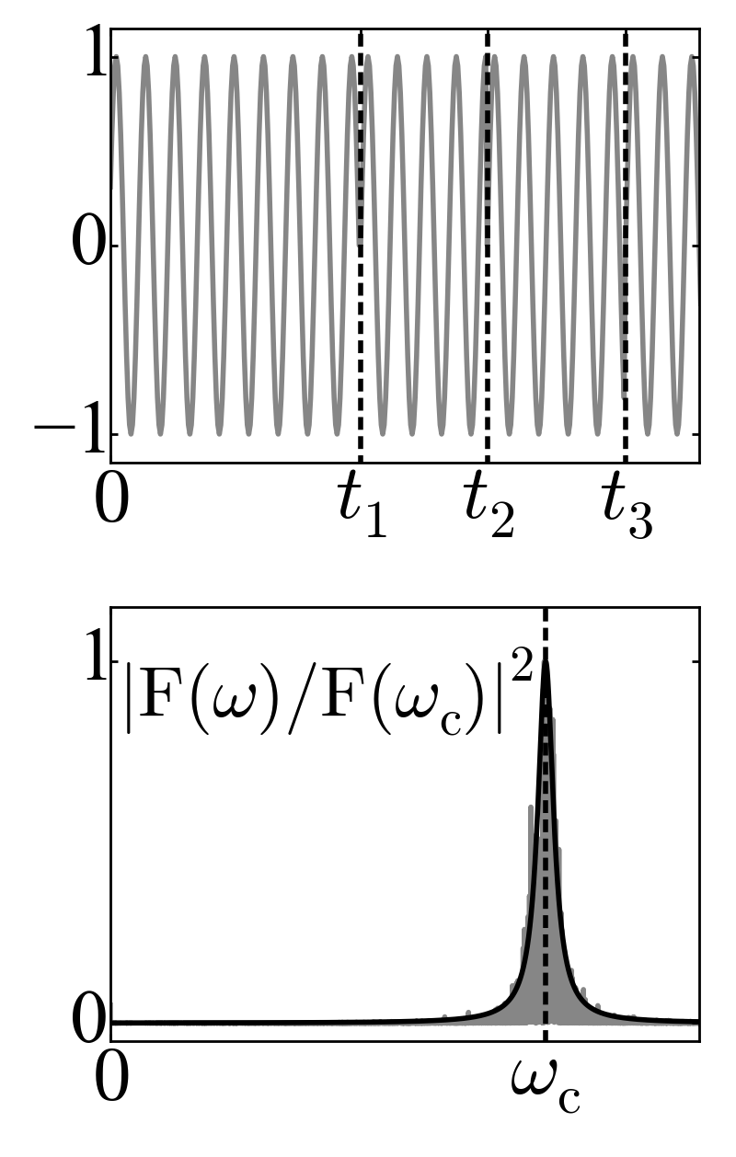
Coherence time
OPTICS f2f p 129

Slide 4
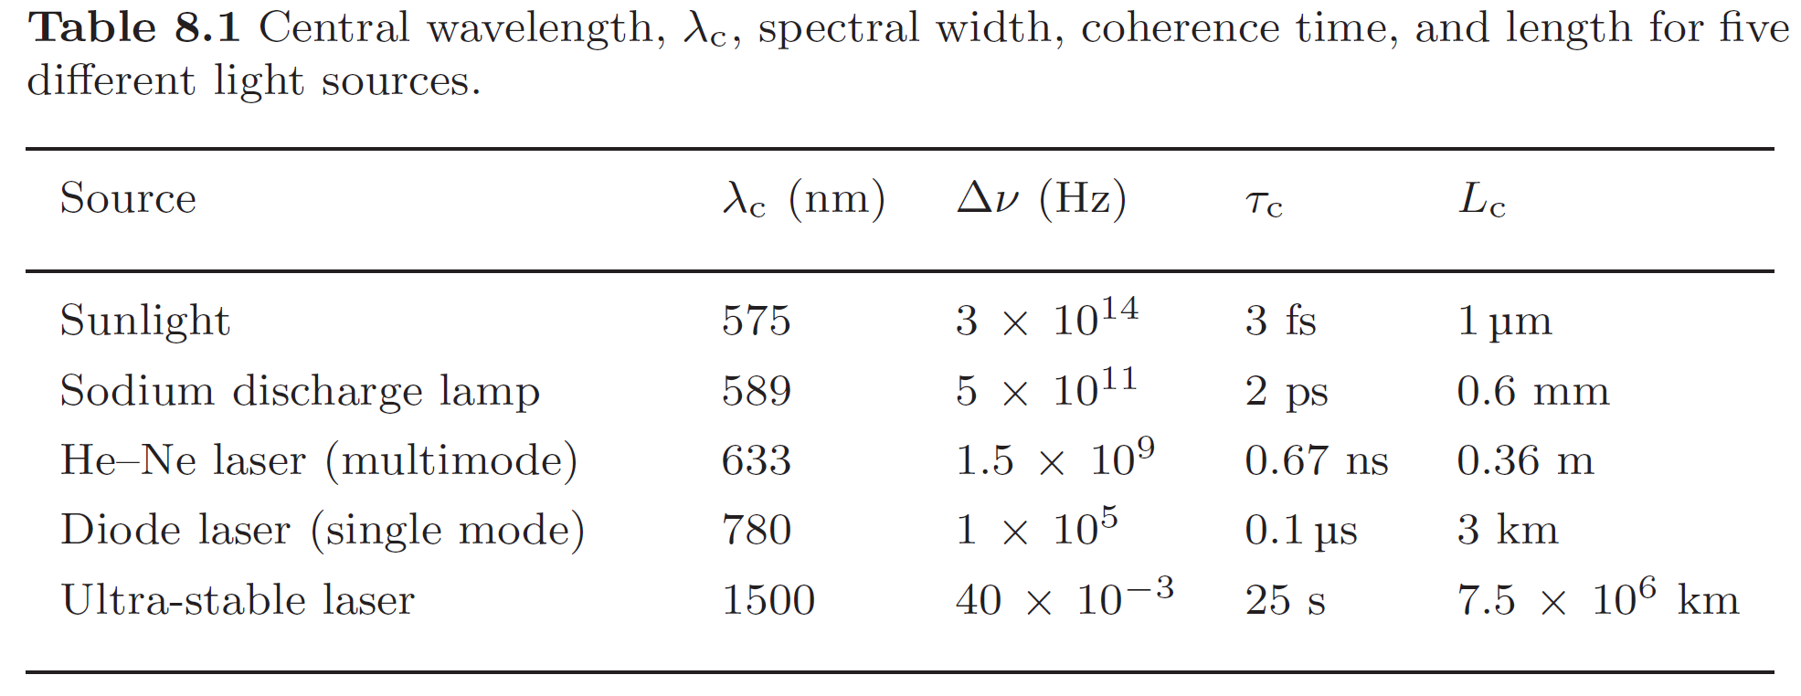
Coherence times and lengths
OPTICS f2f p 130

Slide 5
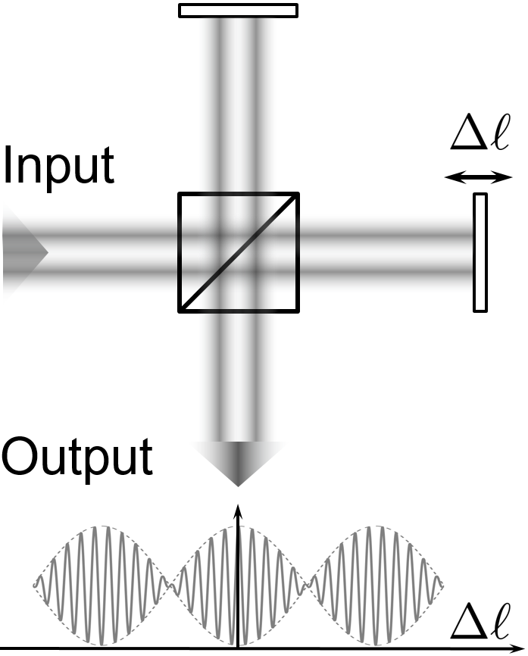
Michelson interferometer
Interference between a beam and a time-delayed version
OPTICS f2f p 130

Slide 6
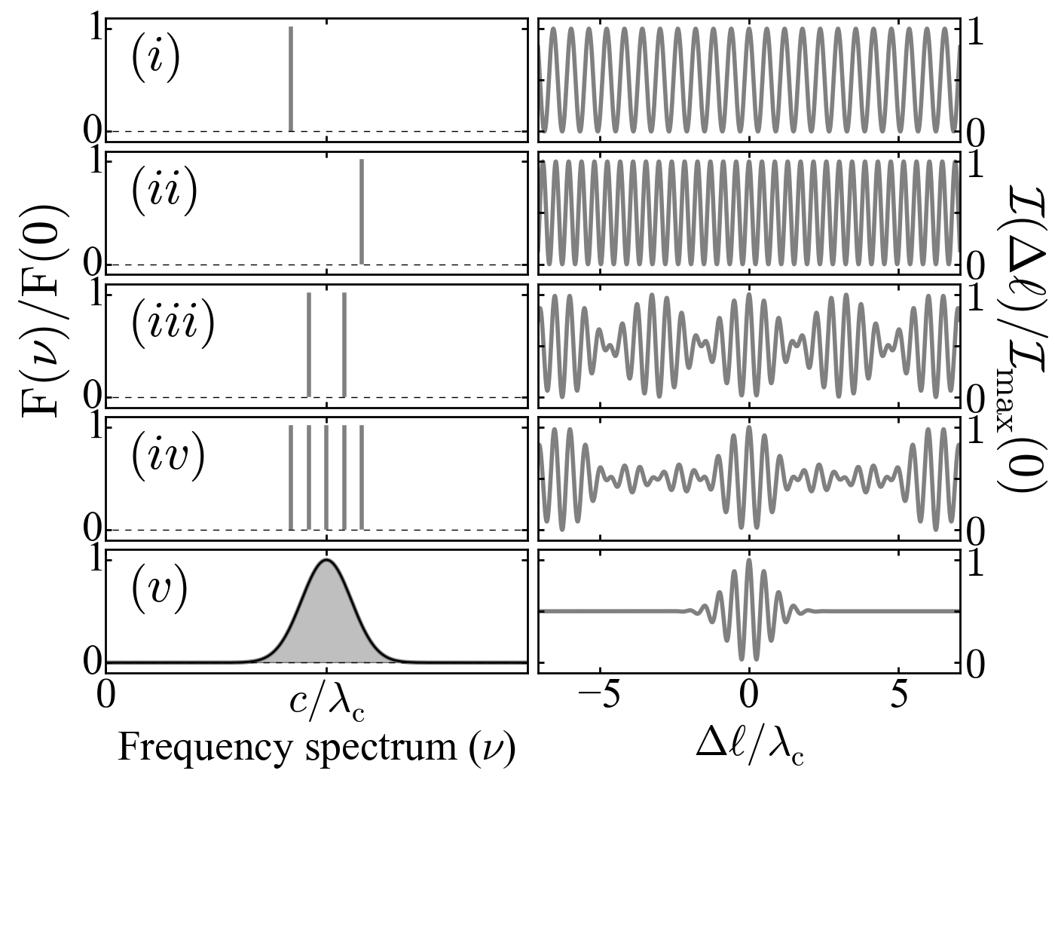
Interferograms and spectra
OPTICS f2f p 131

Slide 7
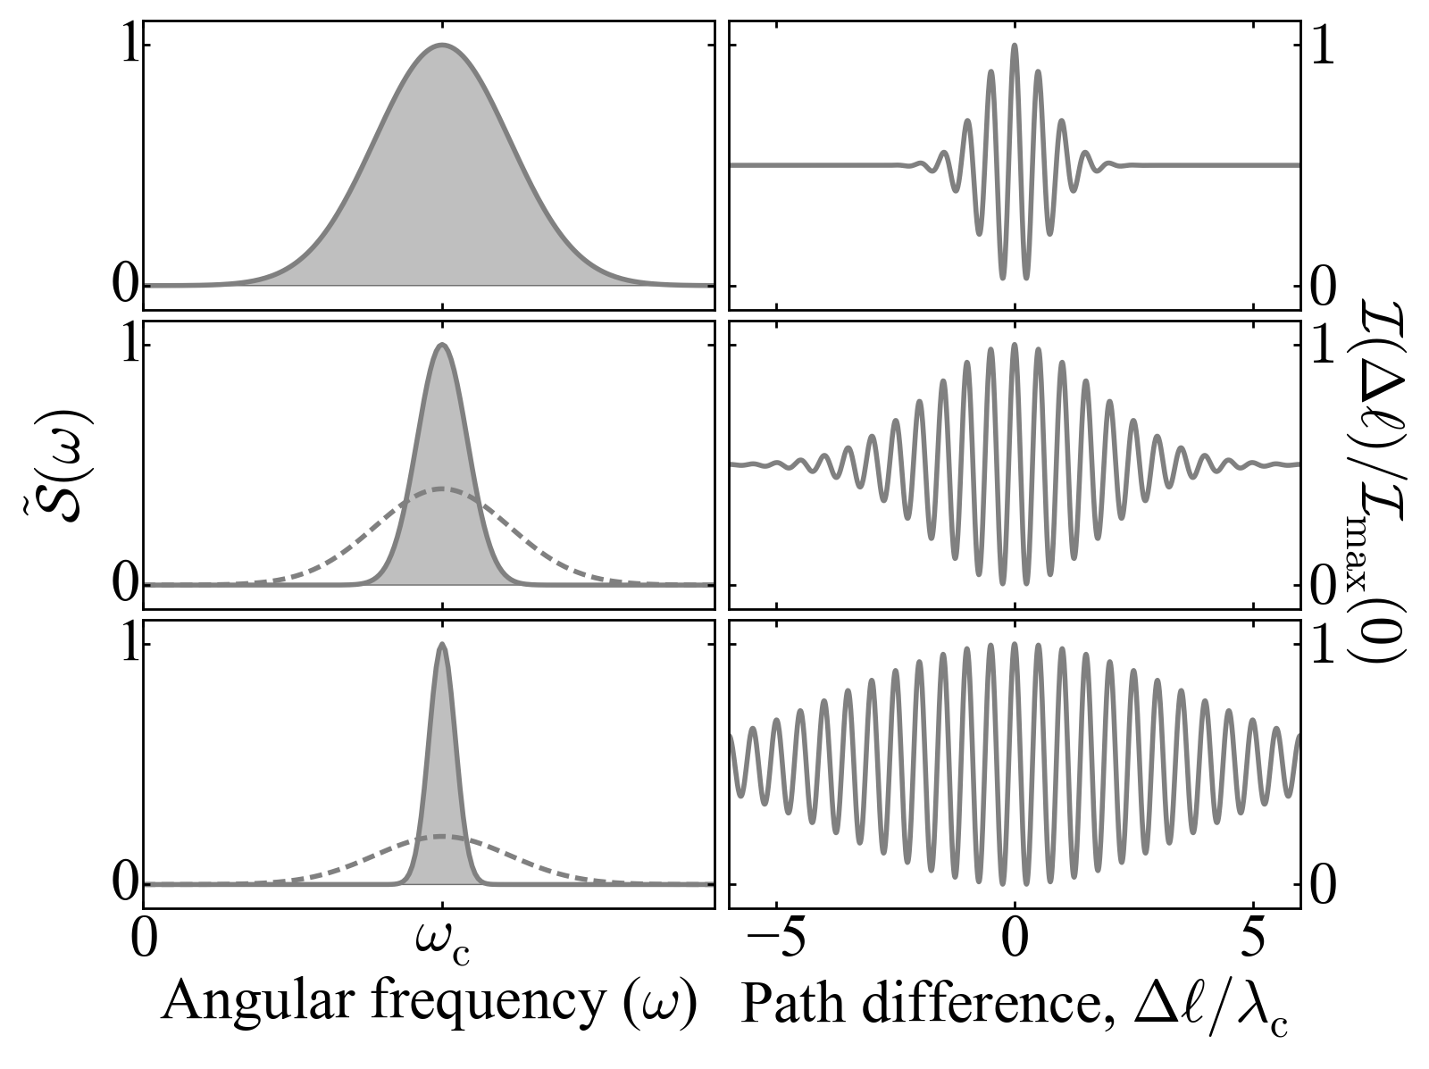
Fourier transform spectroscopy
OPTICS f2f p 135

Slide 8
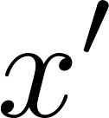
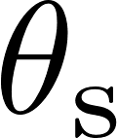
Young’s double slit interferometer
OPTICS f2f p 137

Slide 9
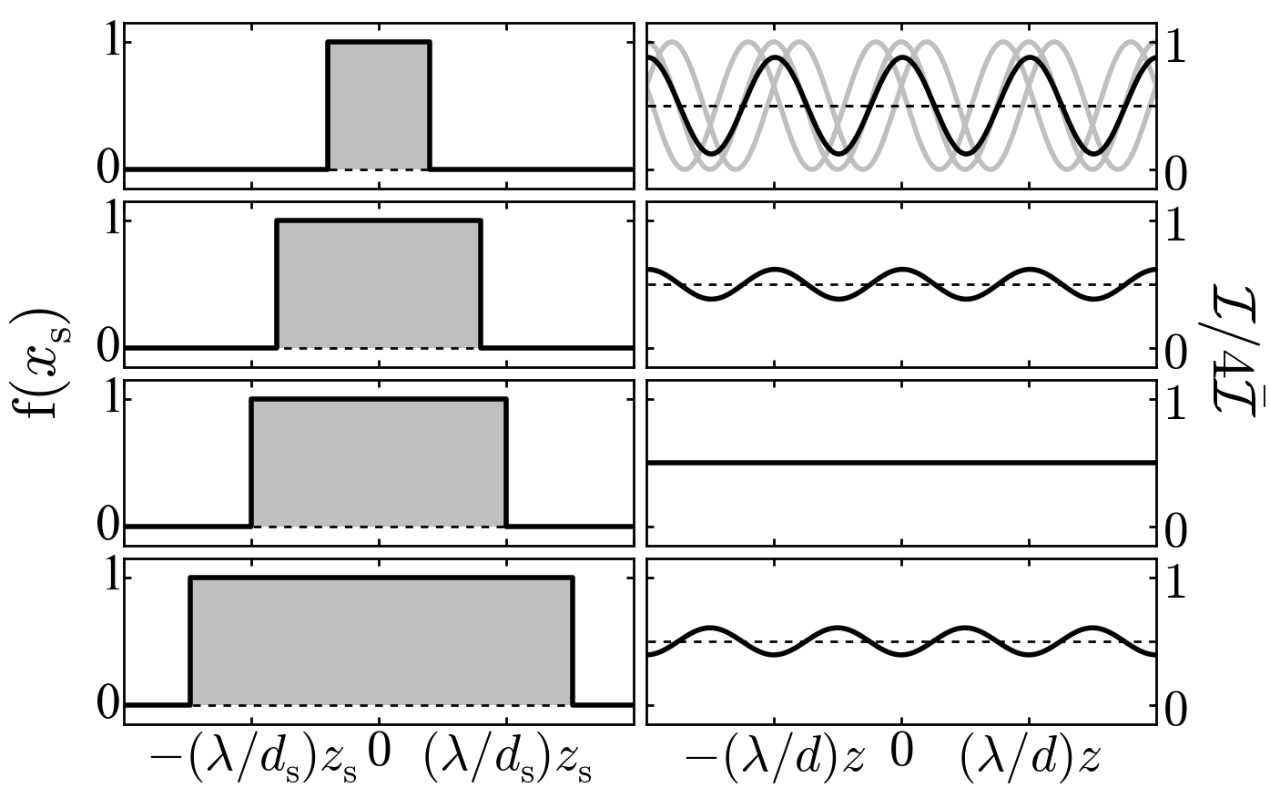
OPTICS f2f p 137

Slide 10
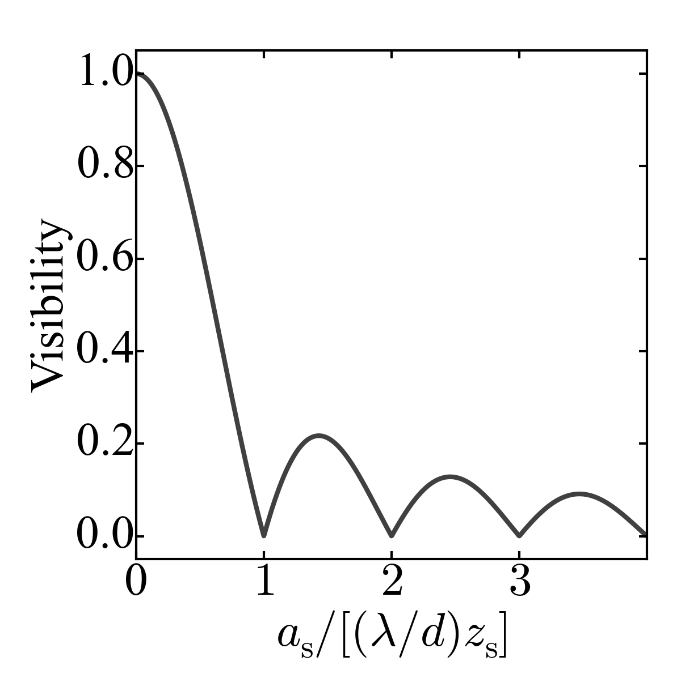
OPTICS f2f p 137

Slide 11
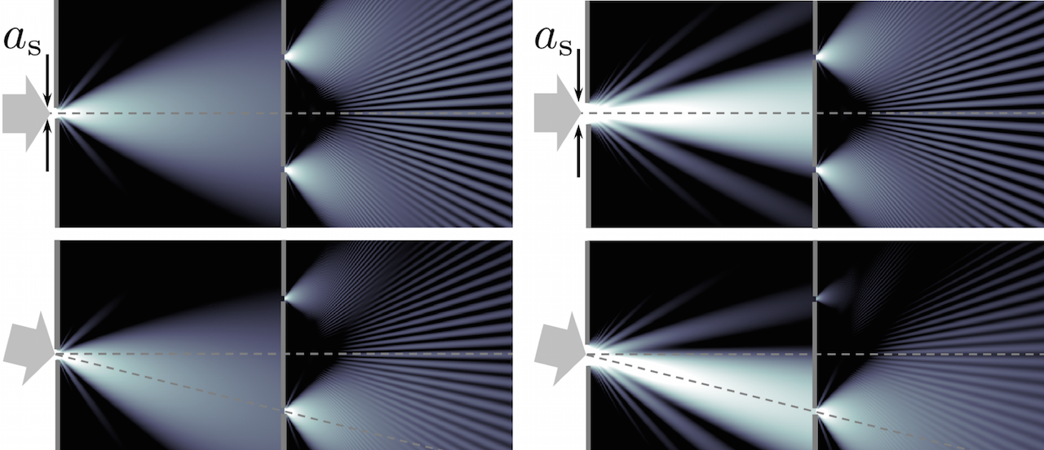
OPTICS f2f p 139

Slide 12
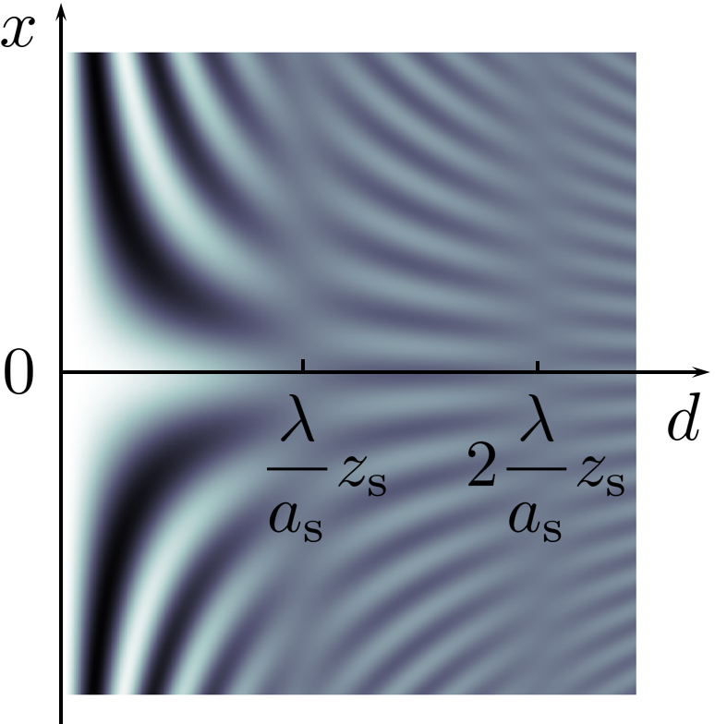
Fringe visibility vs slit separation
OPTICS f2f p 139

Slide 13
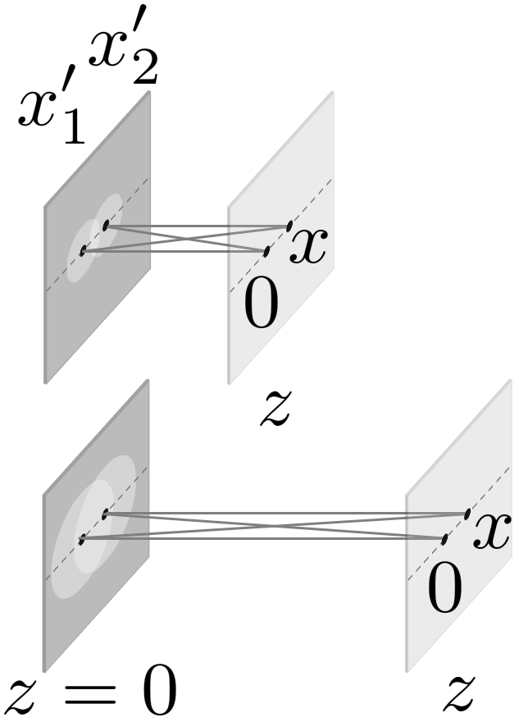
OPTICS f2f p 140

Slide 14
Michelson stellar interferometer
OPTICS f2f p 141

Slide 15
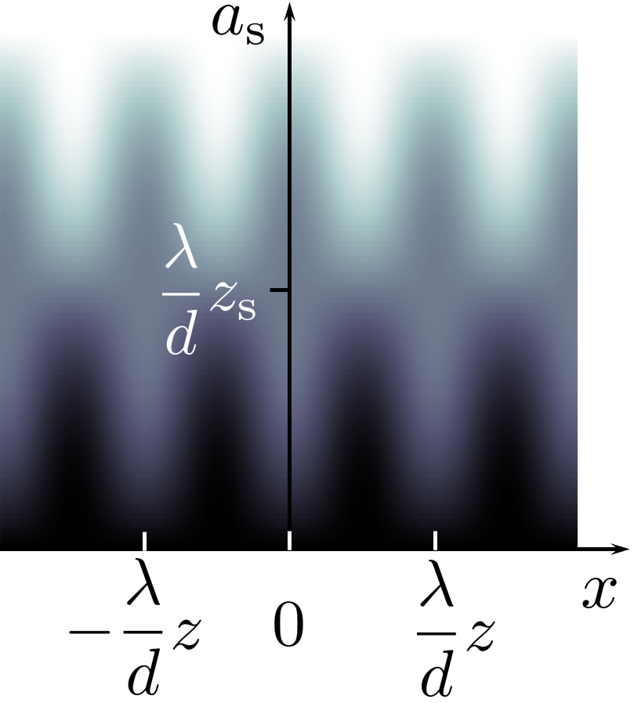
OPTICS f2f p 145

Slide 16
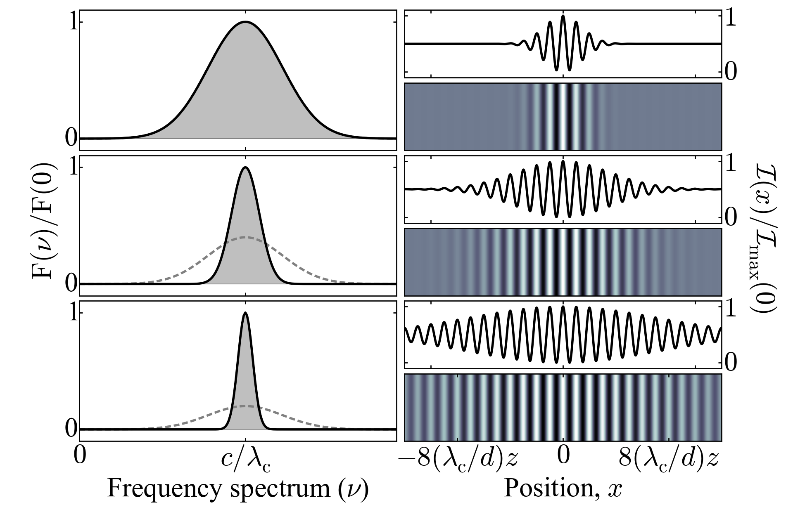
OPTICS f2f p 145

Slide 17
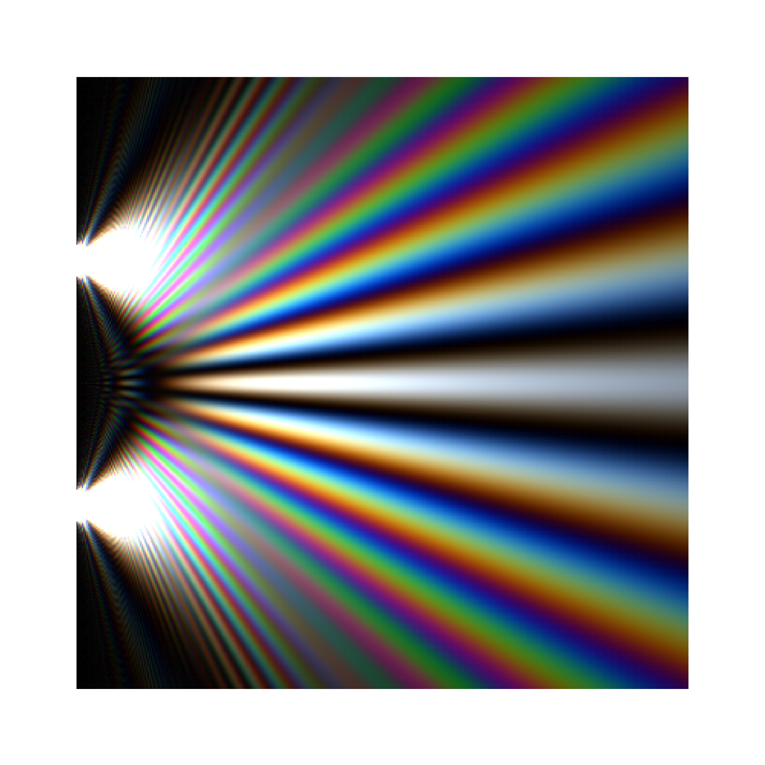
Young’s double slit with white light
OPTICS f2f p 146

