Slide 1
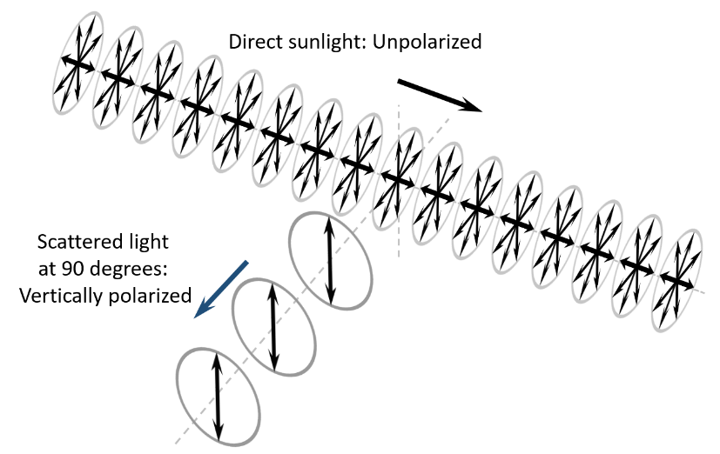
Polarization
Same photo with vertical and horizontal polarizer
OPTICS f2f p. 51

Slide 2
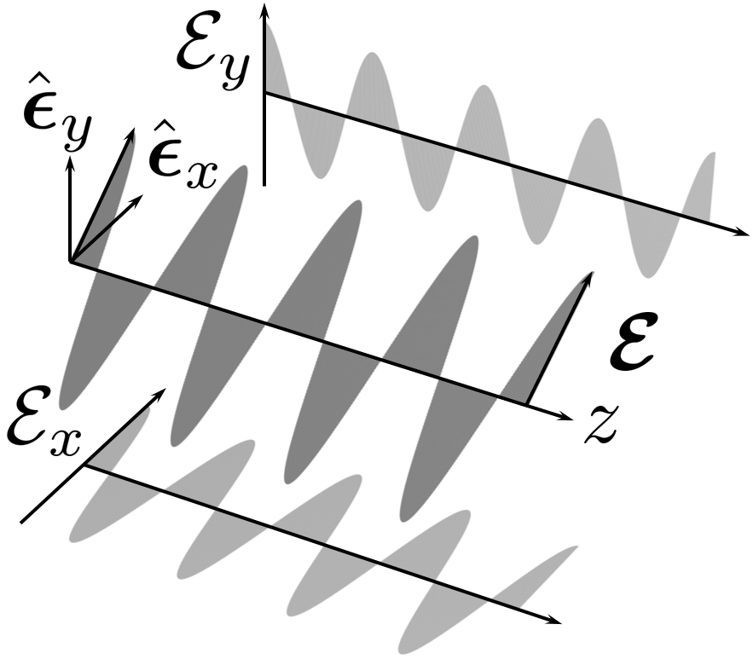
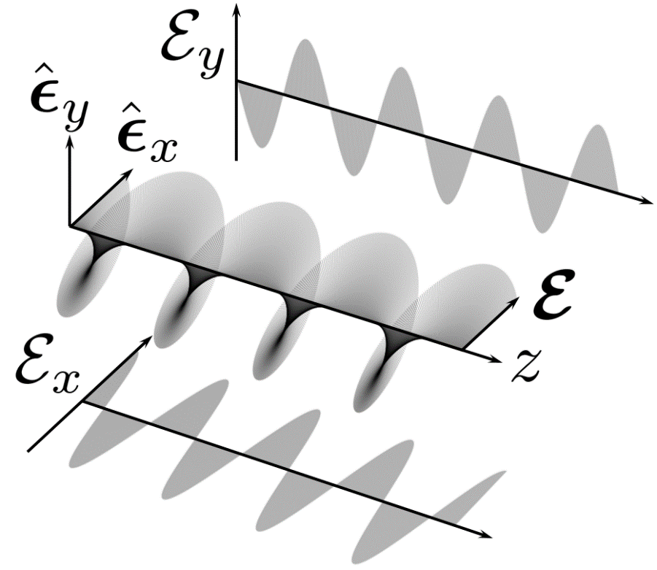
Polarization: Linear and Circular
OPTICS f2f p. 53

Slide 3
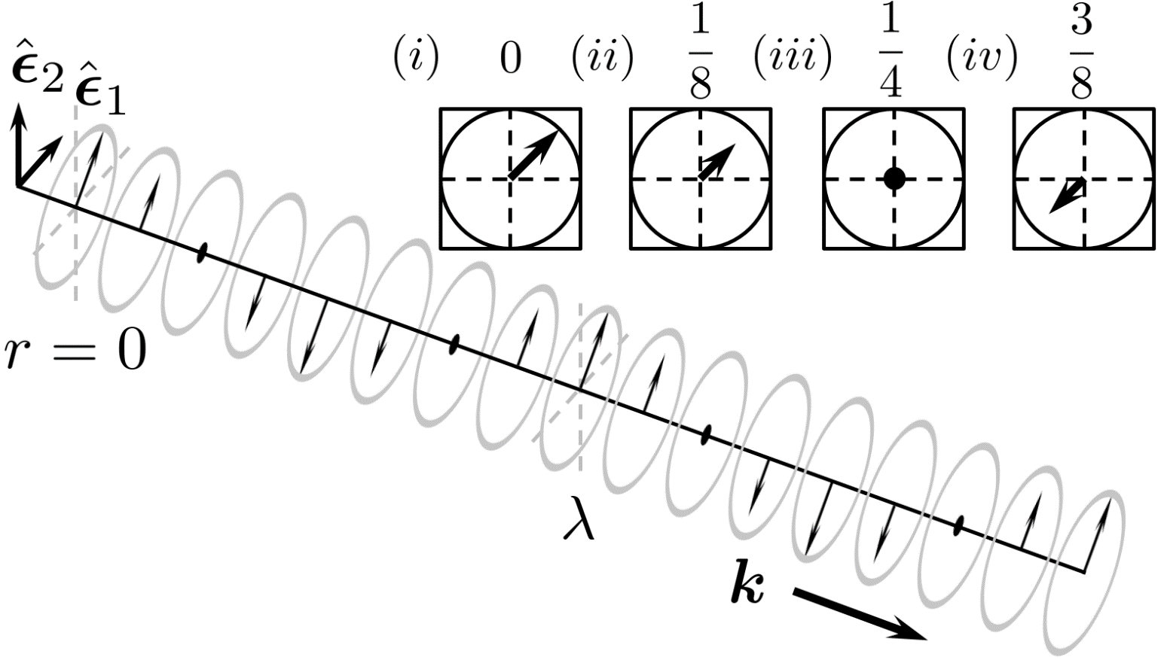
Polarization: Linear (space and time)
OPTICS f2f p. 53

Slide 4
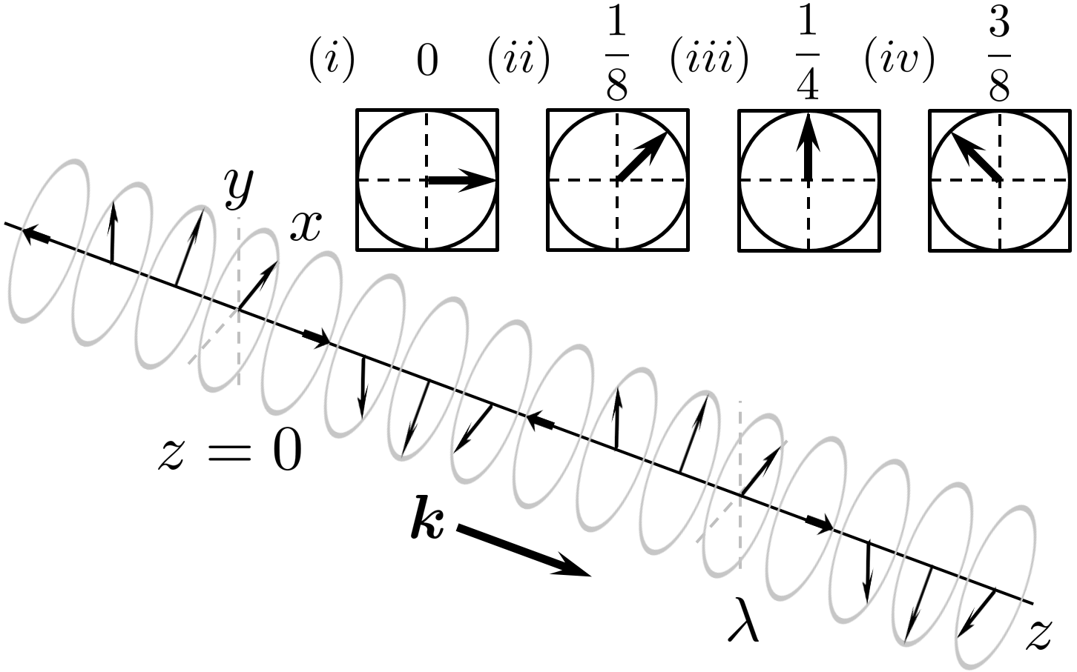
Polarization: Circular (space and time)
OPTICS f2f p. 54

Slide 5
Polarization: Circular (space and time)
OPTICS f2f p. 54

Slide 6
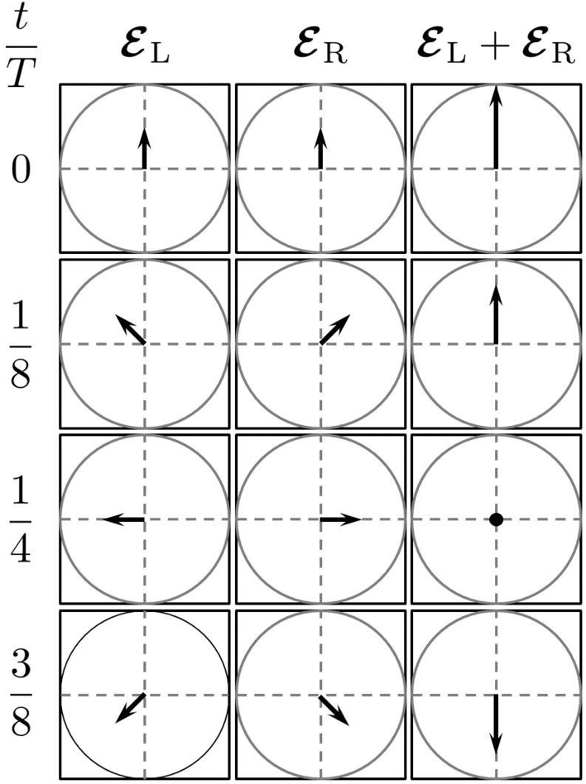
Polarization: Circular basis
OPTICS f2f p. 56

Slide 7
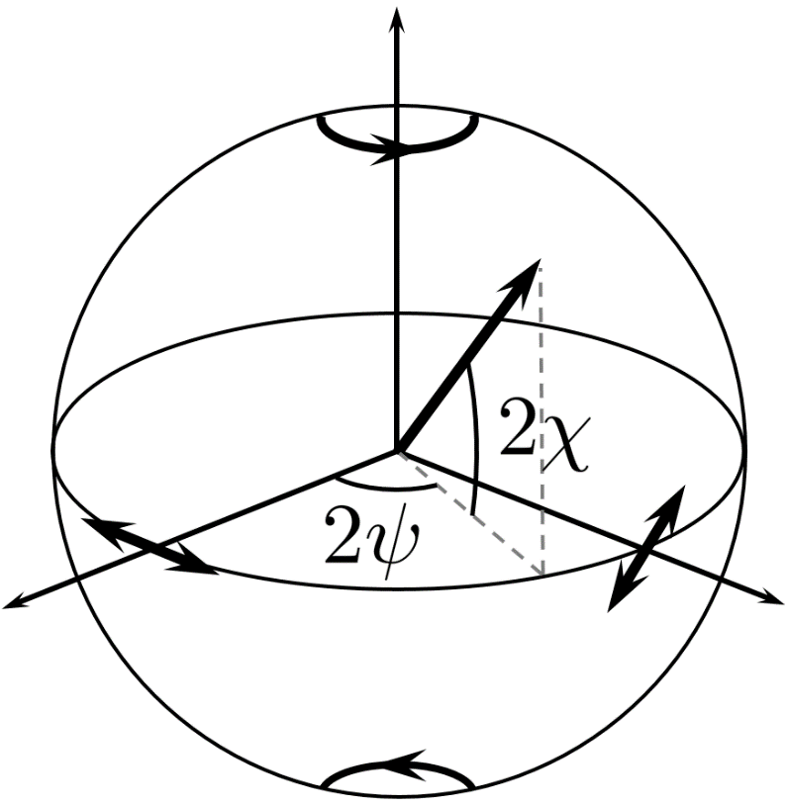
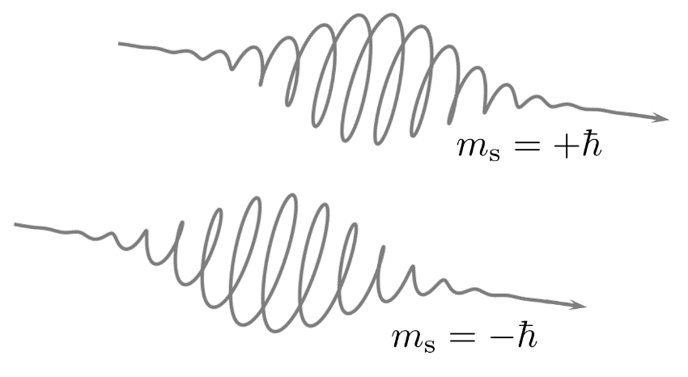
Polarization: Poincare
Photons
OPTICS f2f p. 56

Slide 8
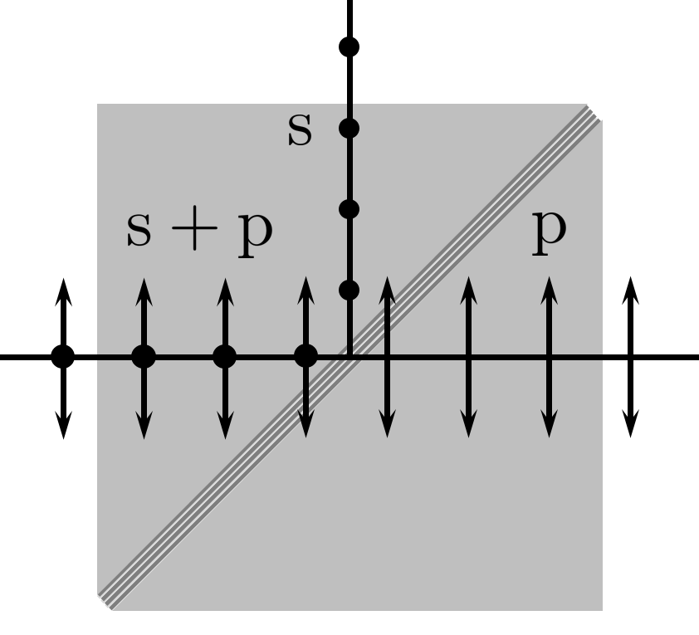
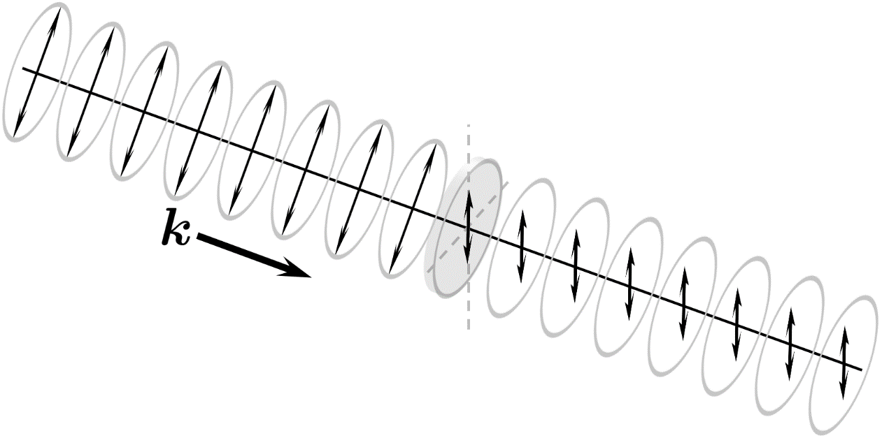
Polarizers
OPTICS f2f p. 58

Slide 9
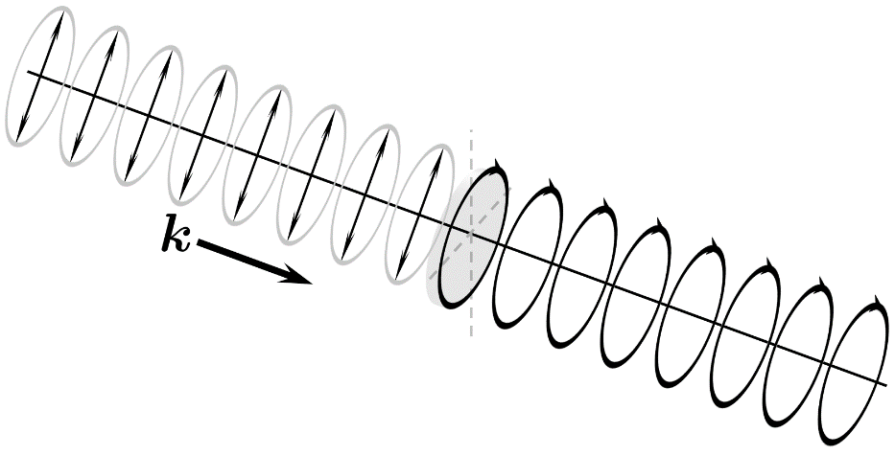
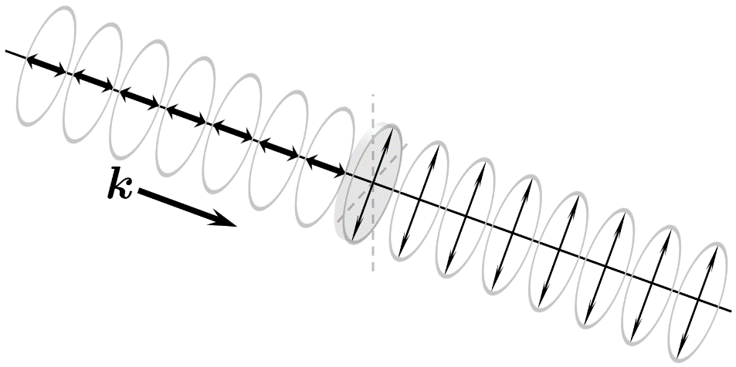
Waveplates
Linear birefringence
OPTICS f2f p. 59

Slide 10
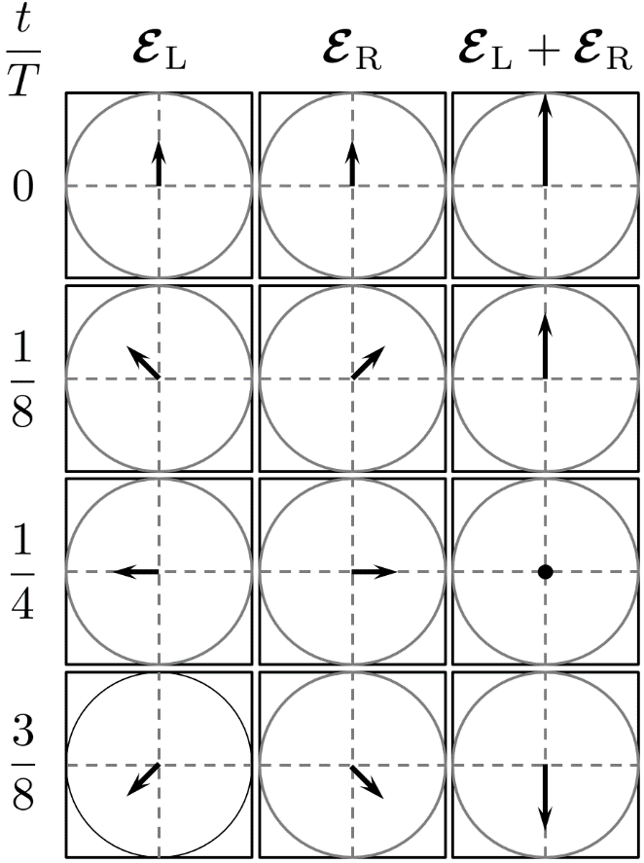
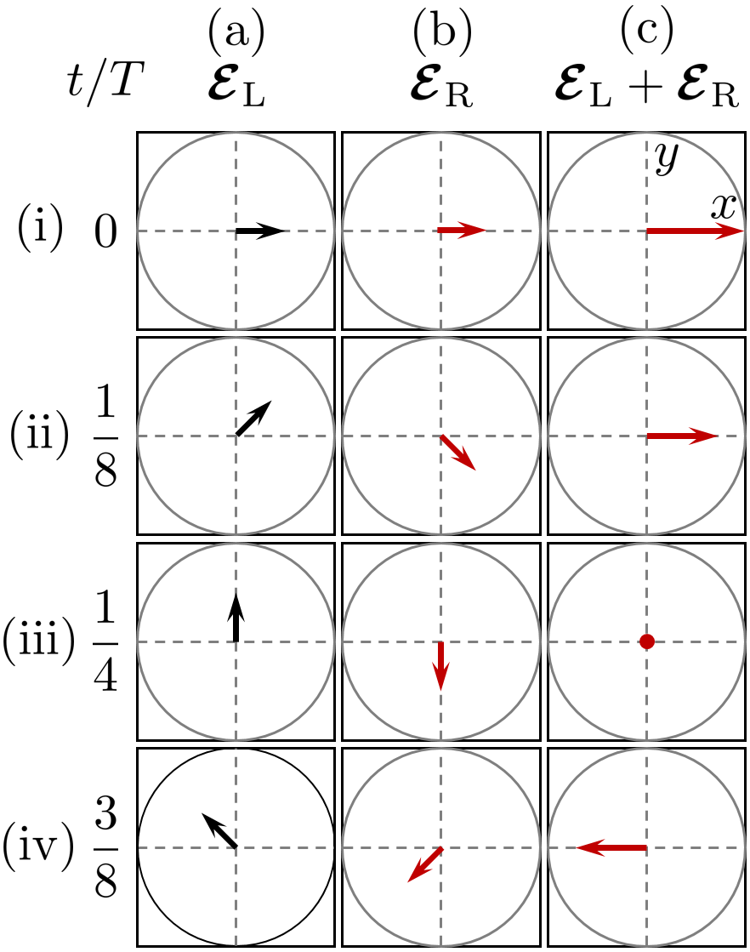
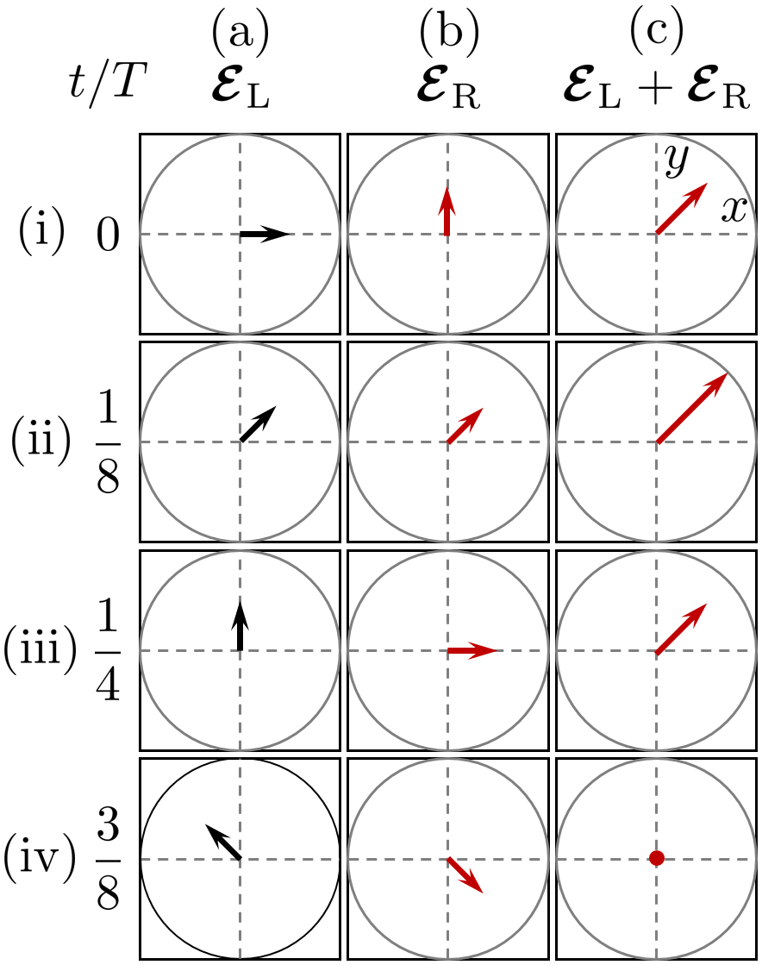
Circular birefringence
Effect of a phase shift
Circular basis
OPTICS f2f p. 61

Slide 11
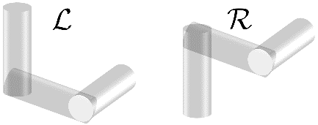
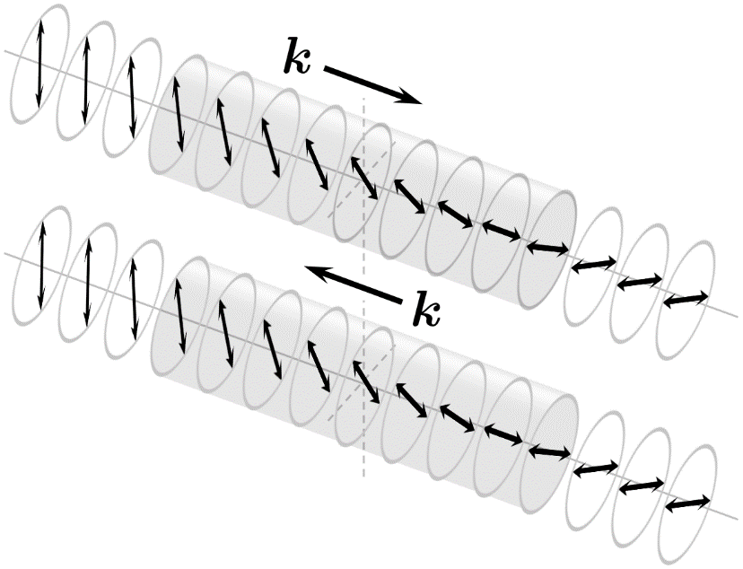
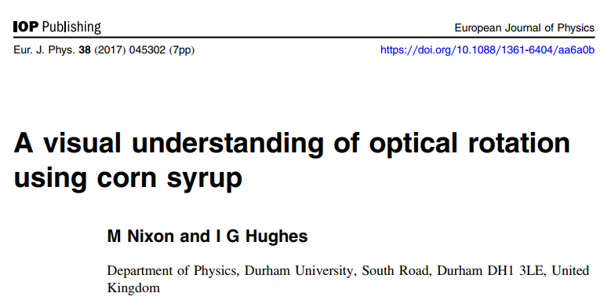
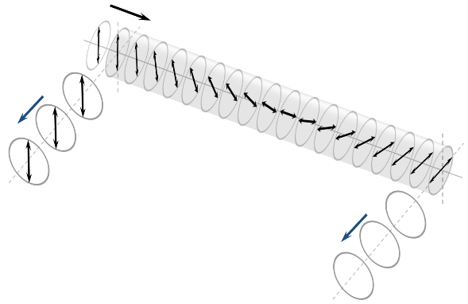
Optical rotation
OPTICS f2f p. 62
See also https://piphase.wordpress.com/2019/01/13/the-sugar-experiment/

Slide 12
Optical rotation: side view with polarizers
Vertical: Scatter + Fluorescence
Horizontal: Only Fluorescence
See also https://piphase.wordpress.com/2019/01/13/the-sugar-experiment/

Slide 13
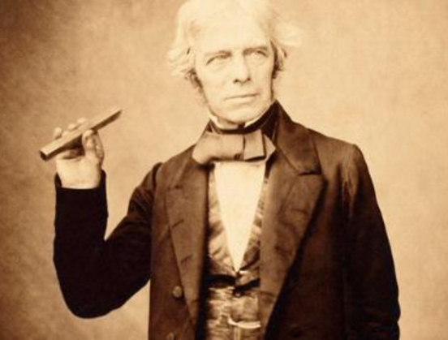
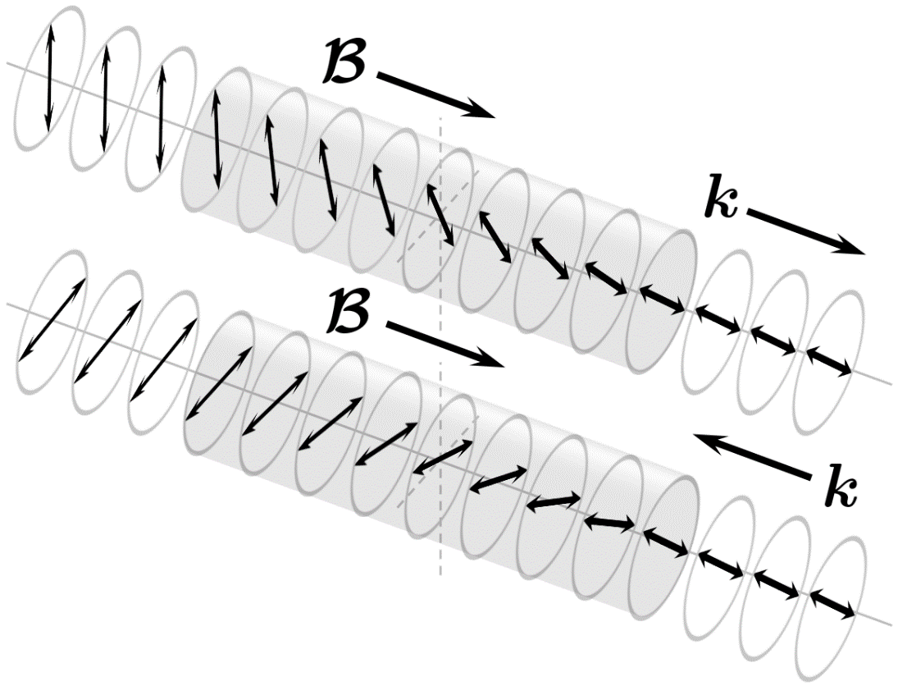
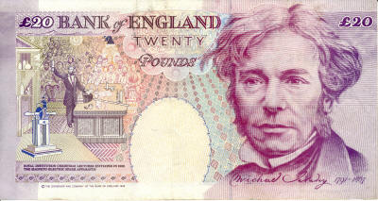
Faraday
OPTICS f2f p. 63

Slide 14
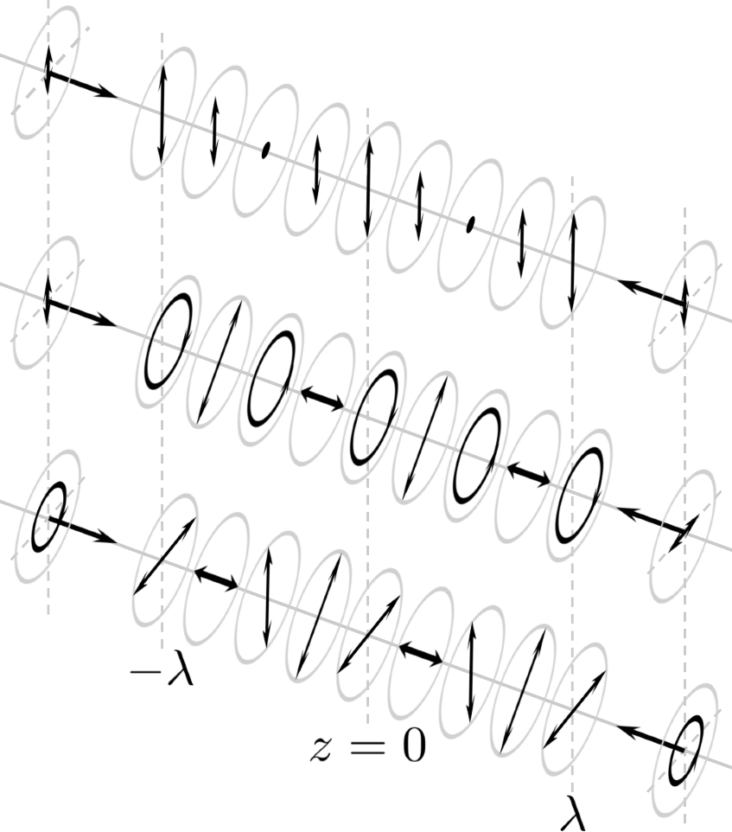
Standing waves
OPTICS f2f p. 65

