Slide 1
Plane and spherical
OPTICS f2f p. 16

Slide 2
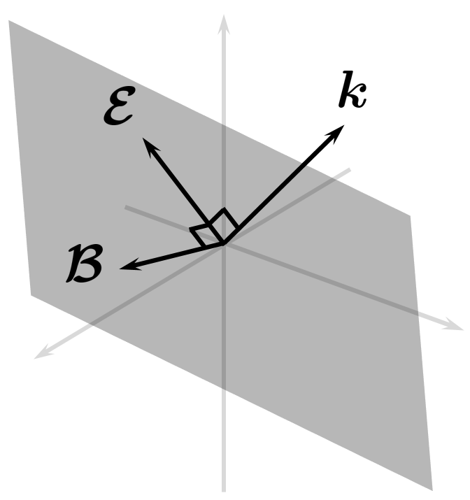
Plane waves: orthogonality
OPTICS f2f p. 17

Slide 3
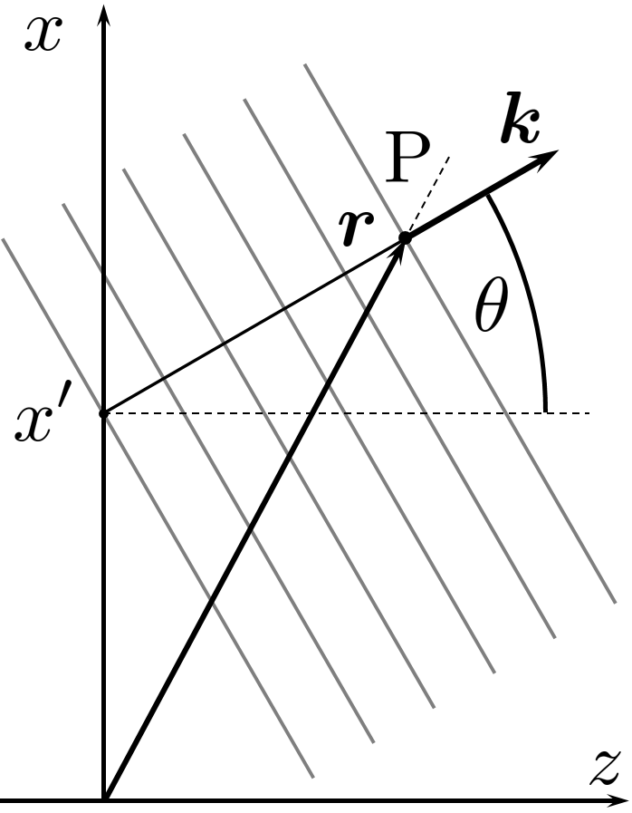
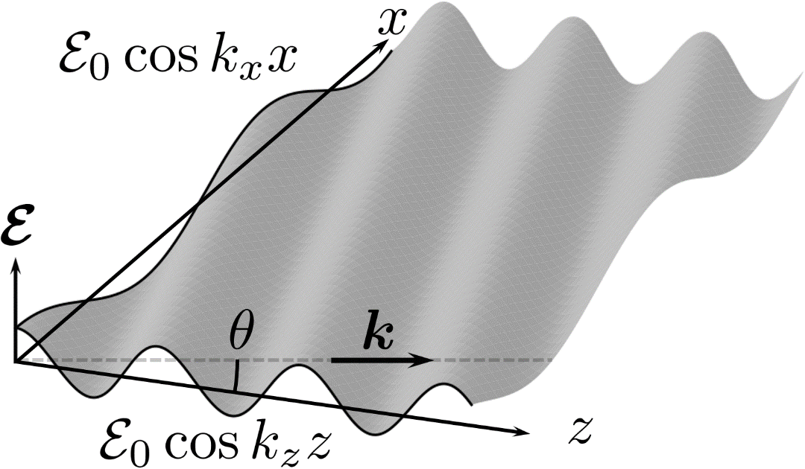
Plane waves: scalar
OPTICS f2f p. 18

Slide 4
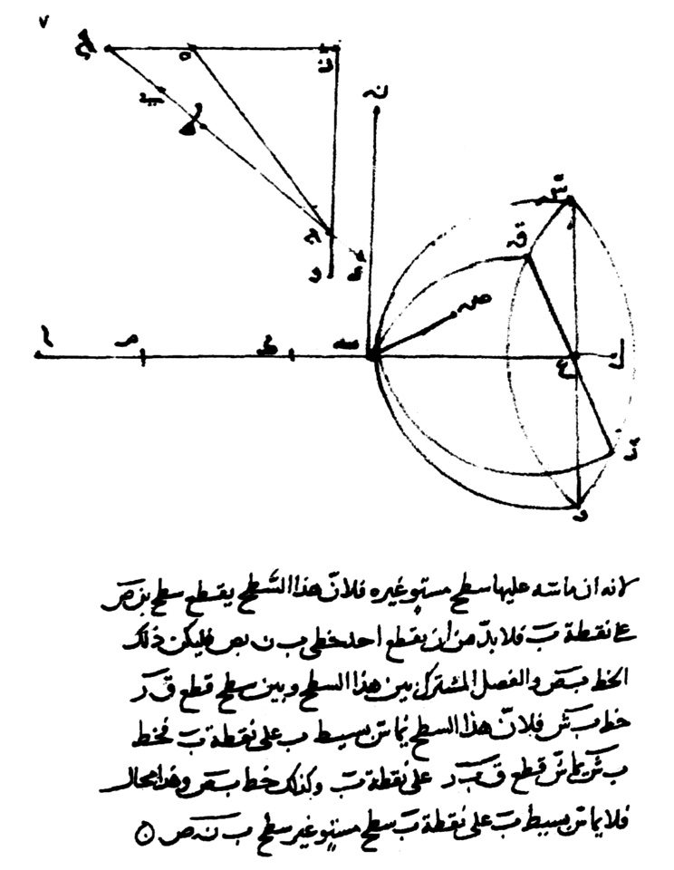
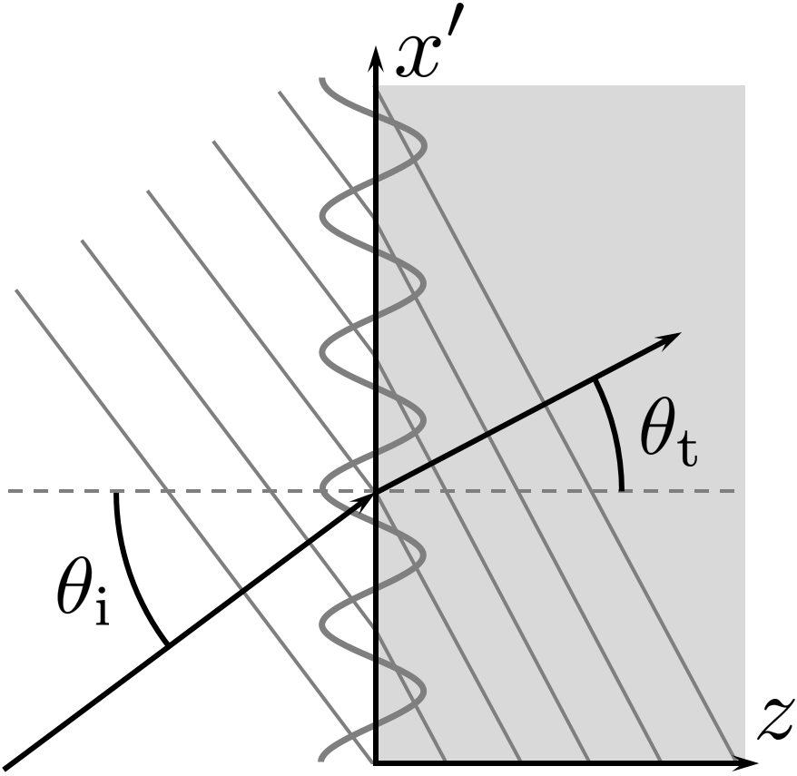
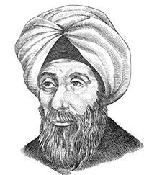
Plane waves: refraction
The law of Ibn Sahl
On burning mirrors and lenses, 983
OPTICS f2f p. 20

Slide 5
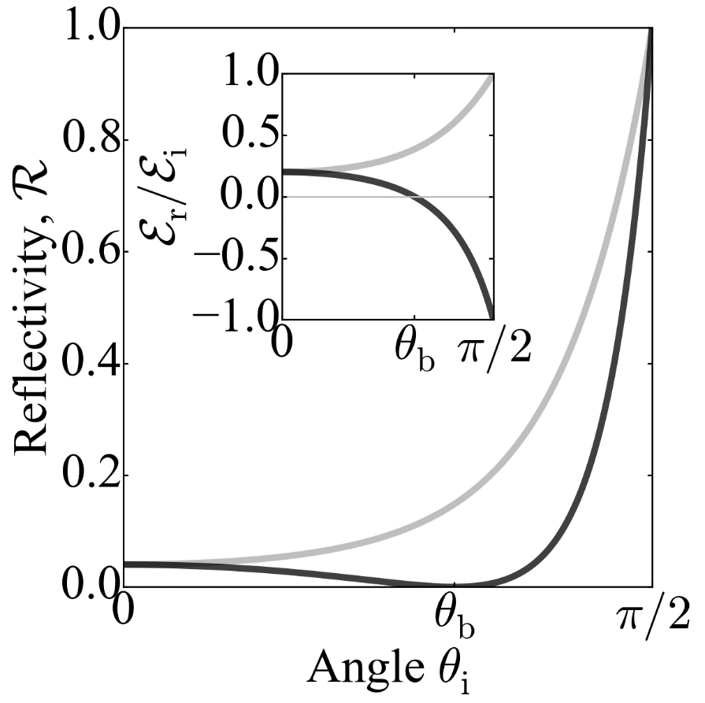
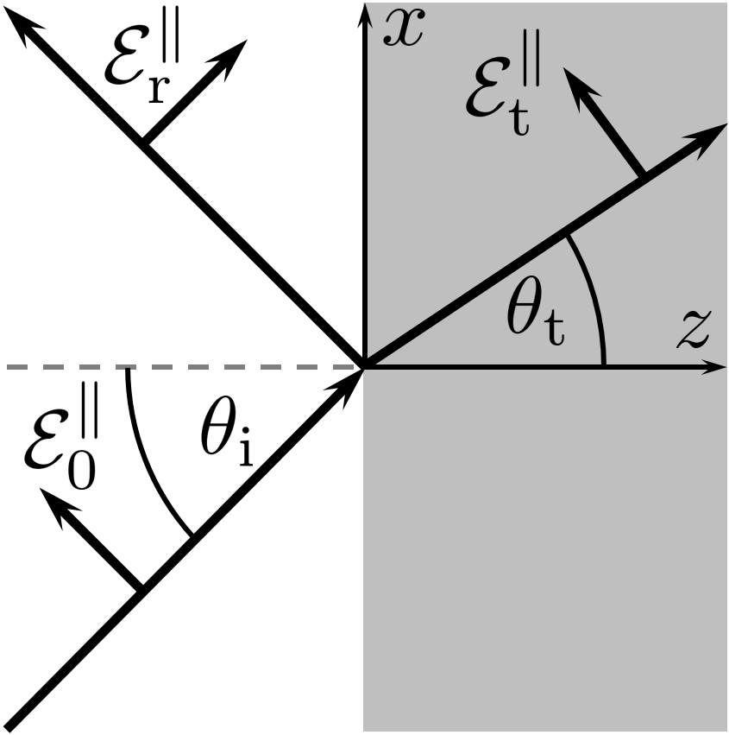
Plane waves: reflection
OPTICS f2f p. 21

Slide 6
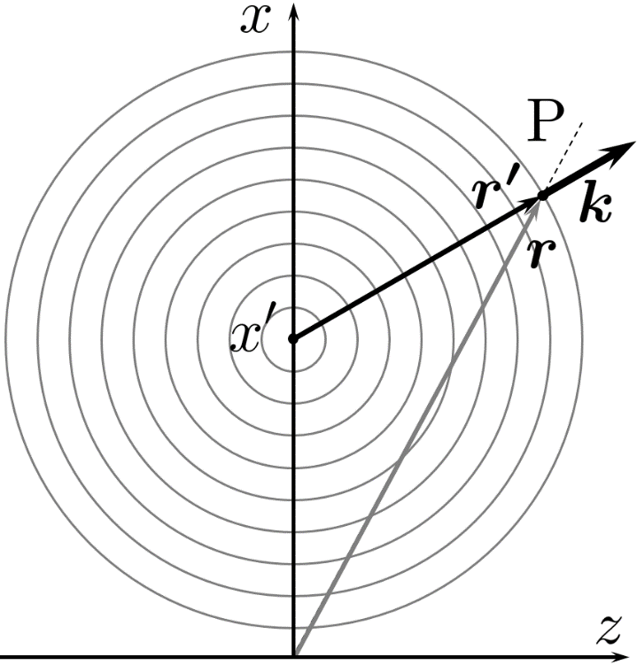
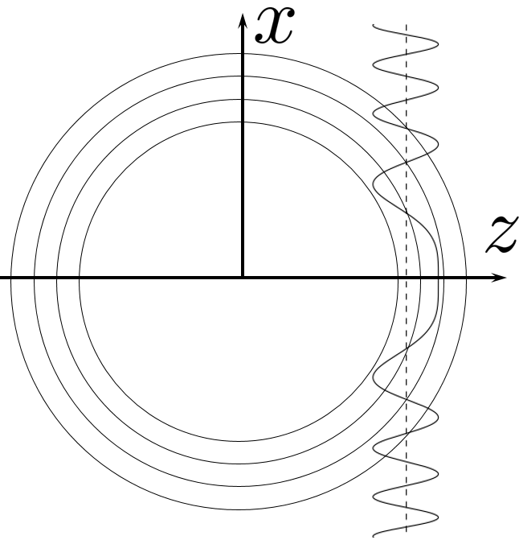
Curved waves
Phase front
OPTICS f2f p. 23

Slide 7
Curved waves
Phase front
OPTICS f2f p. 23

Slide 8
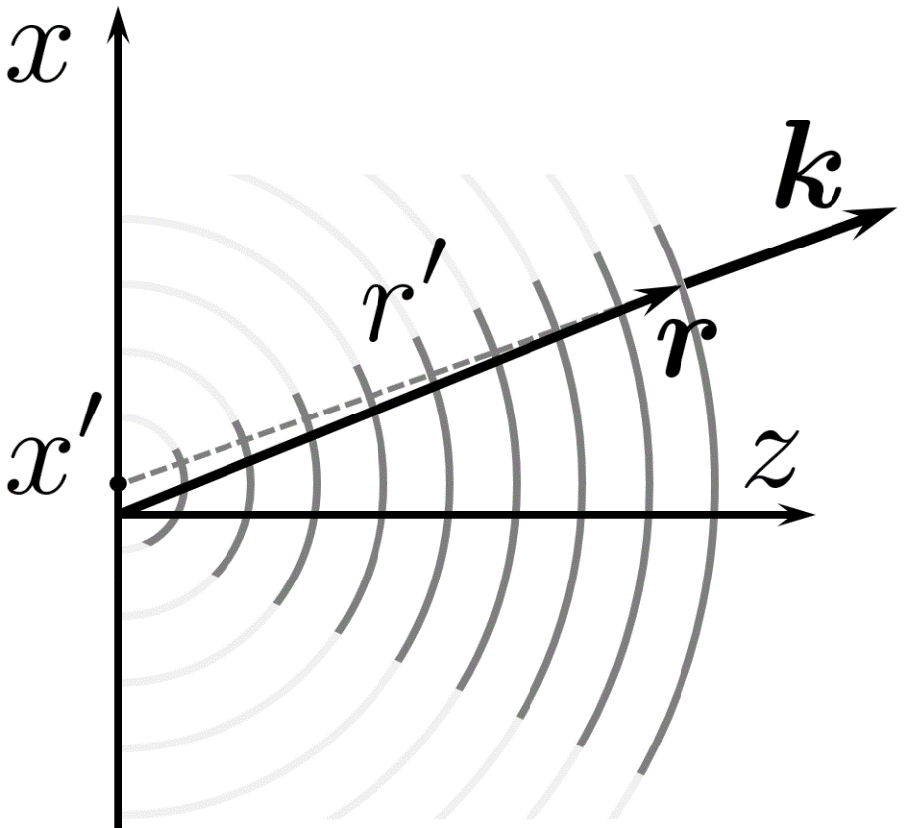
Paraxial curved waves
OPTICS f2f p. 25

Slide 9
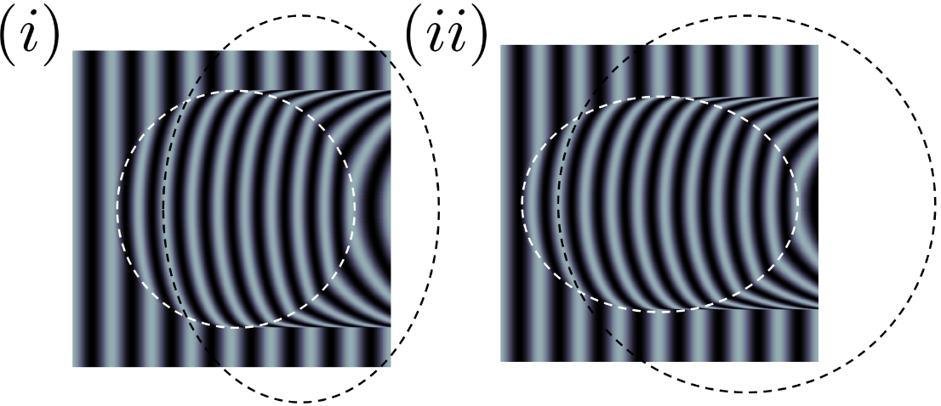
Lenses
On burning mirrors and lenses, 983

Slide 10
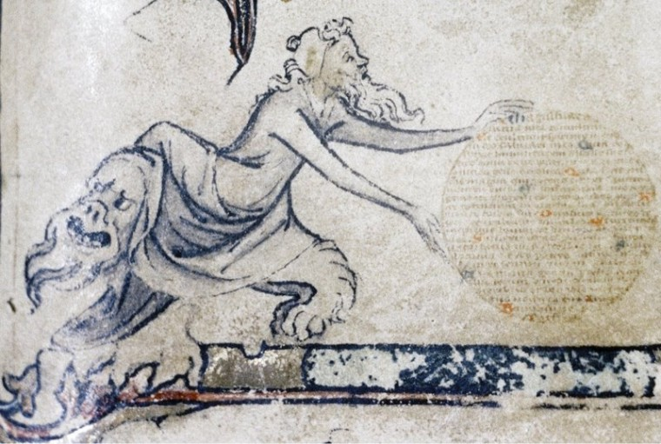
Lenses
Magnificat anima mea Dominum
My soul does magnify the lord.
1350

Slide 11
Applied optics:
history of optical instruments (lens)
Ibn Sahl
On burning mirrors and lenses
984

Slide 12
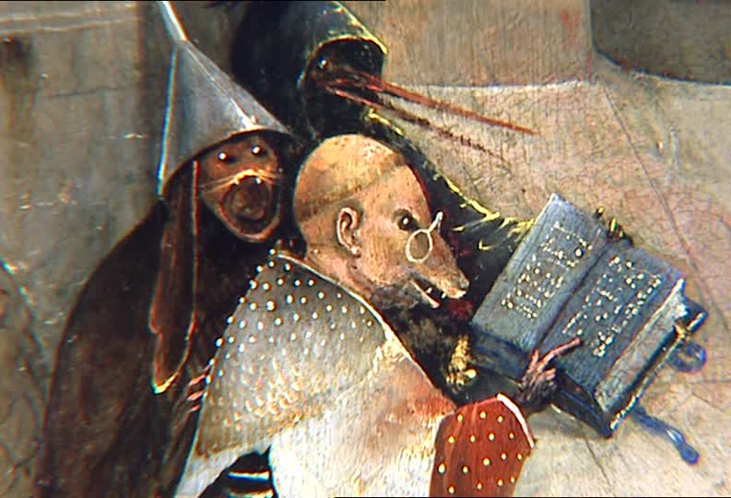
Lenses
Magnificat anima mea Dominum
My soul does magnify the lord.
Hieronymus Bosch (1450-1516)
1350

Slide 13
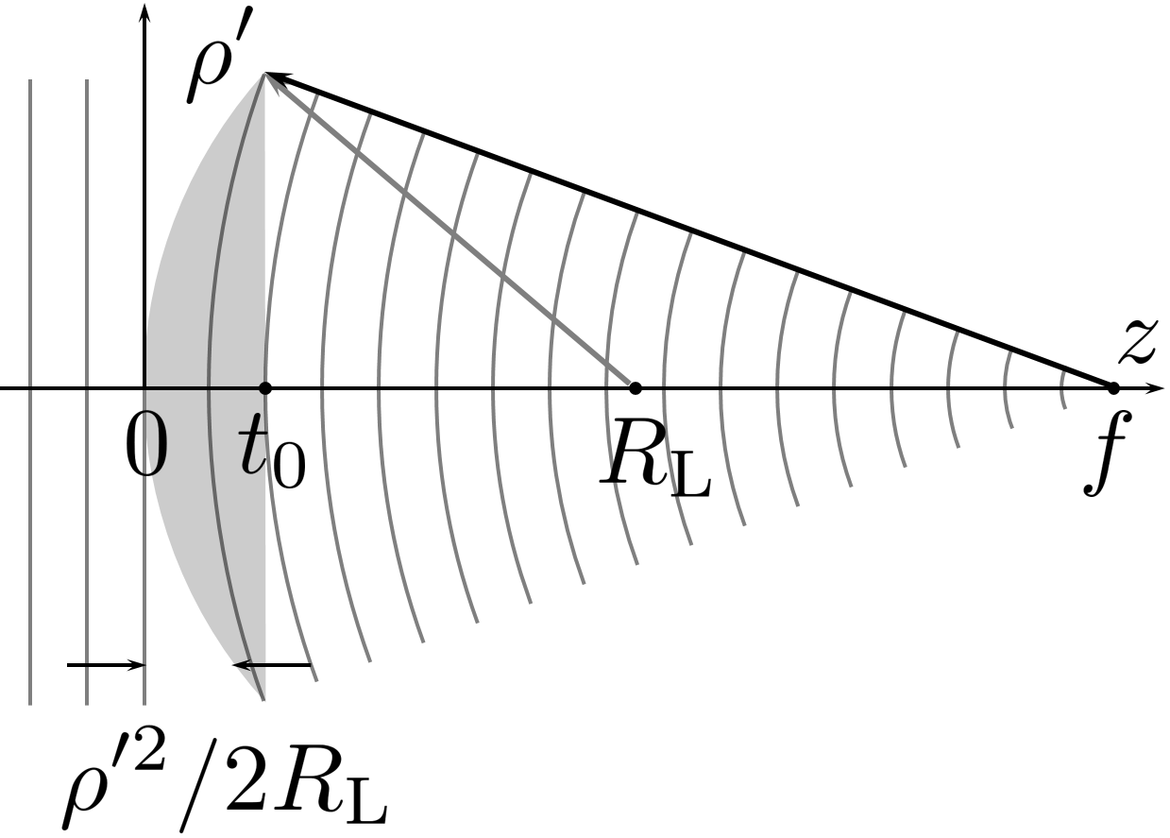
Lens: plane to spherical wave converter

Slide 14
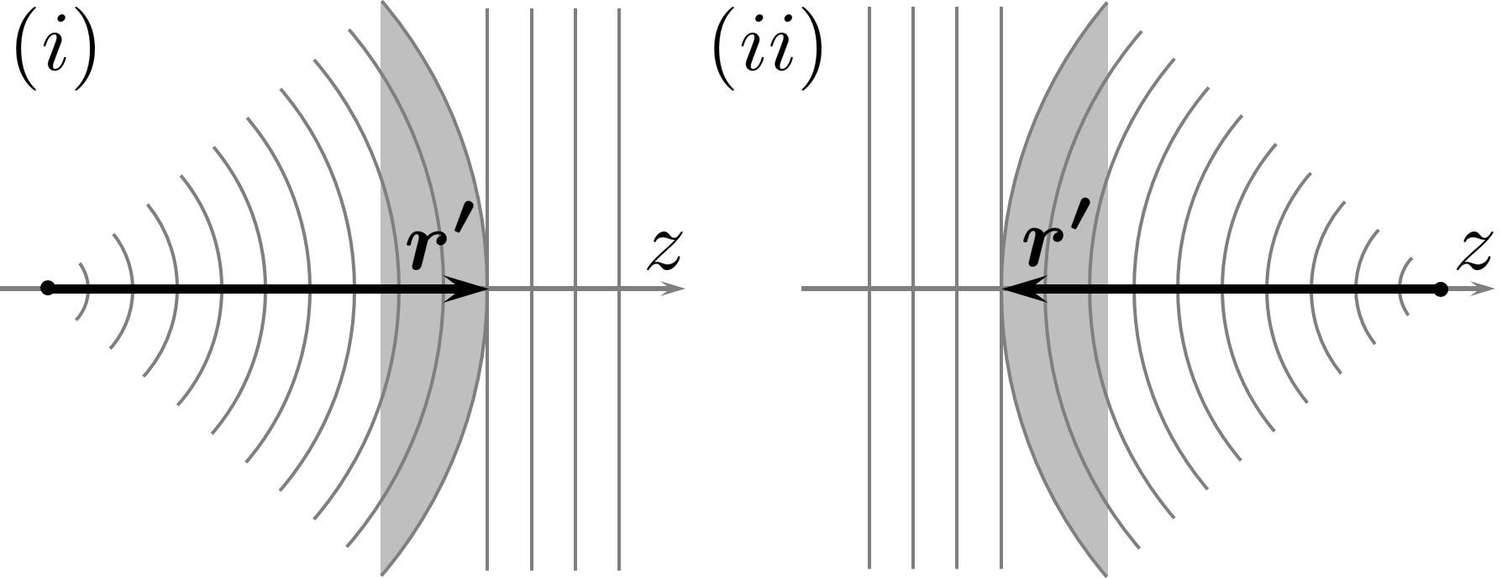
Lens: plane to spherical wave convertion

Slide 15
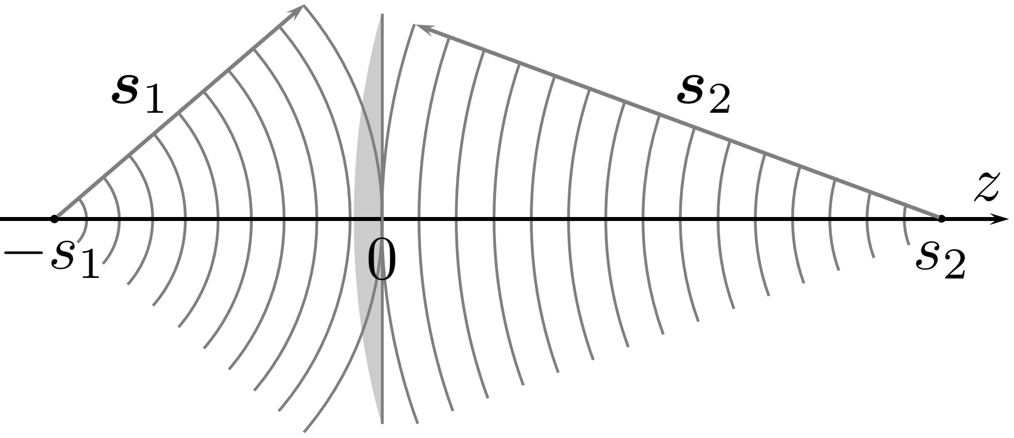
Lens: imaging
Spherical to spherical conversion

