Slide 1
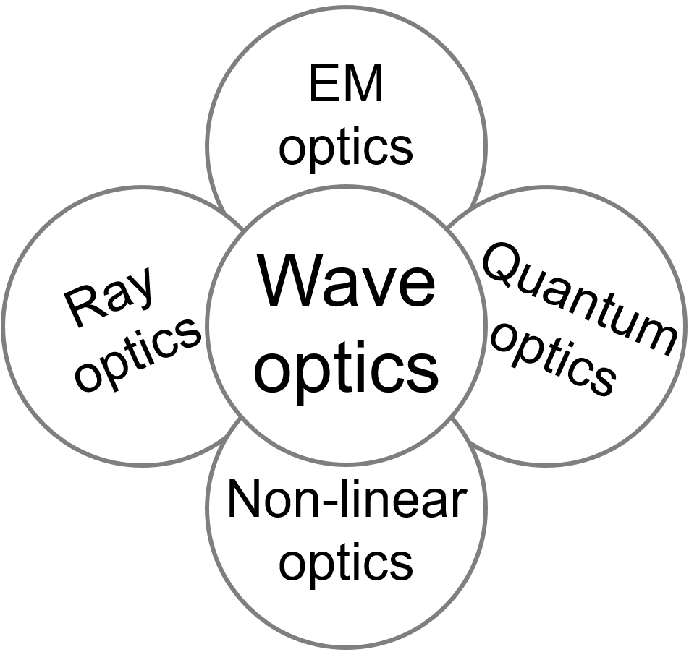
Optics overview
OPTICS f2f p. 1

Slide 2
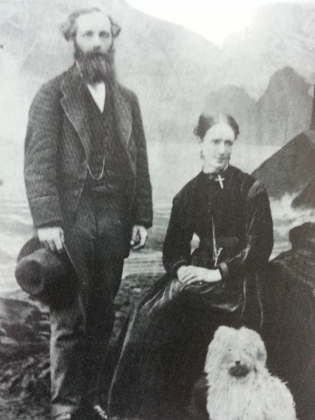
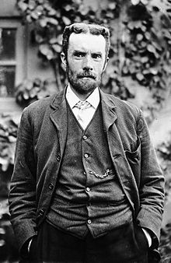
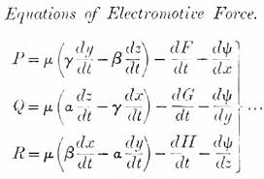
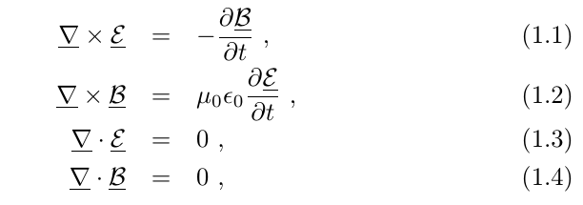
Maxwell-Heaviside equations
Oliver Heaviside (1850-1925)
Maxwell 1864
OPTICS f2f p. 2

Slide 3
Principle of superposition
One wave
Two examples:
Plane and spherical
Two waves
Principle of superposition
Solutions
Also a solution
Many waves
Build complex light fields from simple solutions
OPTICS f2f p. 3

Slide 4
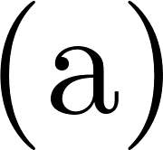
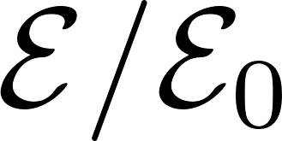
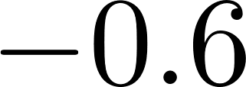
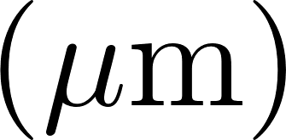
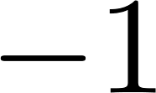
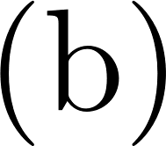
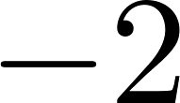
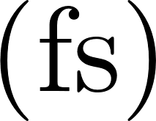
Monochromatic light
Harmonic wave
OPTICS f2f p. 4

Slide 5
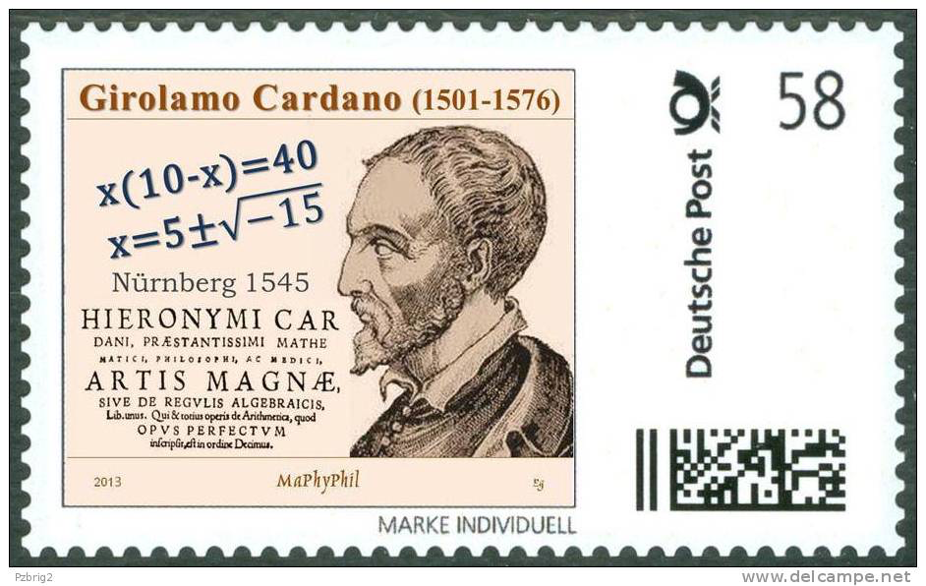
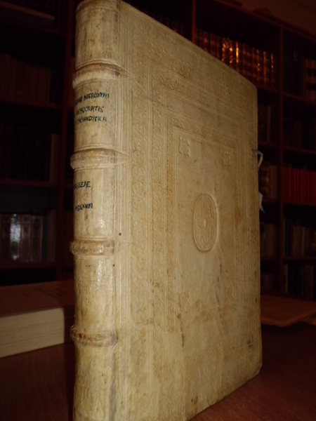
Harmonic wave:
complex notation
Complex numbers “quantitas sophistica”
Il giocatore d’azzado di Milano
Often we can put
Short hand is not to write c.c.
OPTICS f2f p. 8

Slide 6
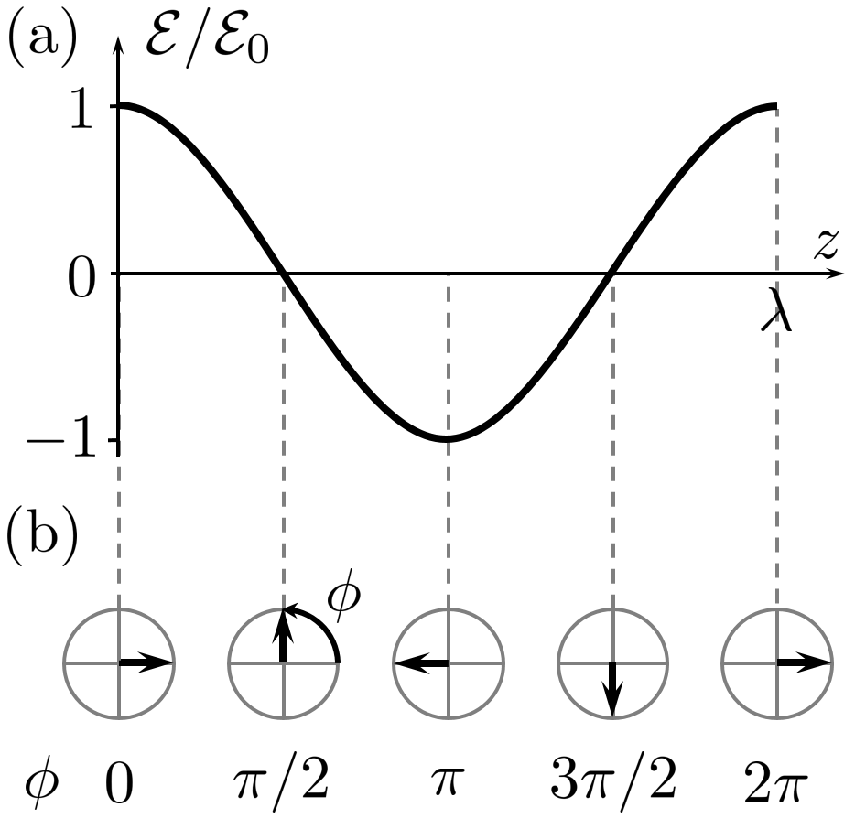
Phasors
OPTICS f2f p. 5

Slide 7
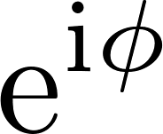
Phasors
OPTICS f2f p. 5
Phasor (in complex plane)
Axis of imaginary numbers
positive
Phase lag
Axis of
real numbers

Slide 8
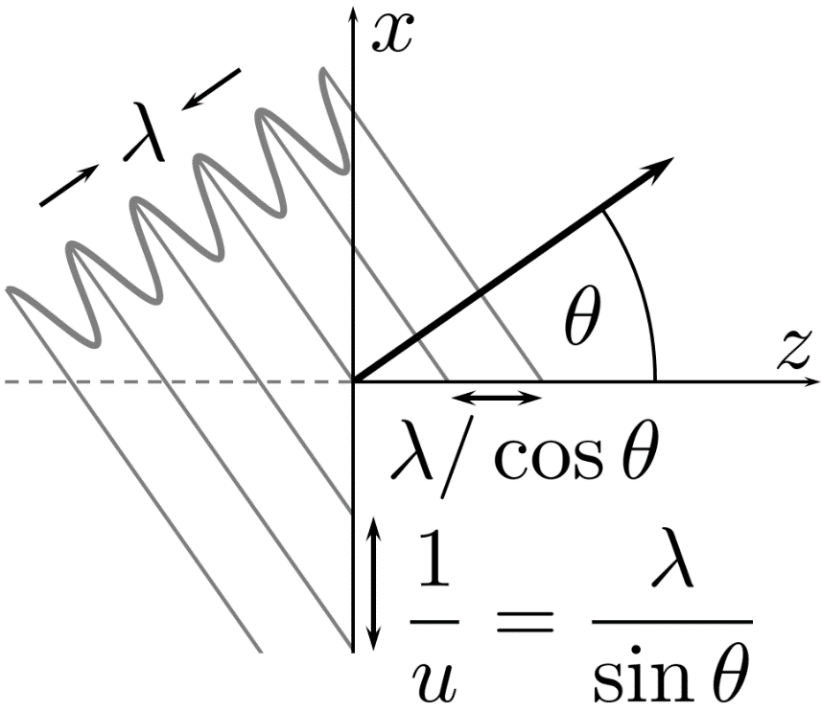
Spatial frequency
OPTICS f2f p. 6

Slide 9
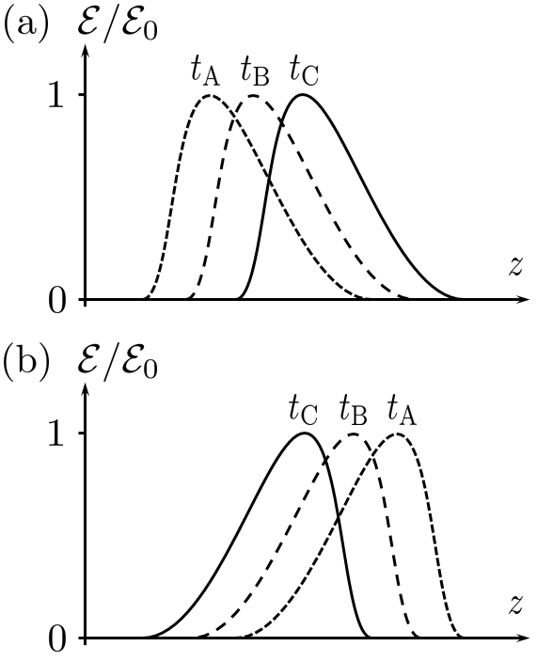
Time propagation
OPTICS f2f p. 10

