Slide 1
=
+
+
+
+
+…

Slide 2
y
x
Central spot only transmitted
Central, +1 and −1 spots
transmitted
Central, ±2 spots, ±4 spots
etc. transmitted

Slide 3
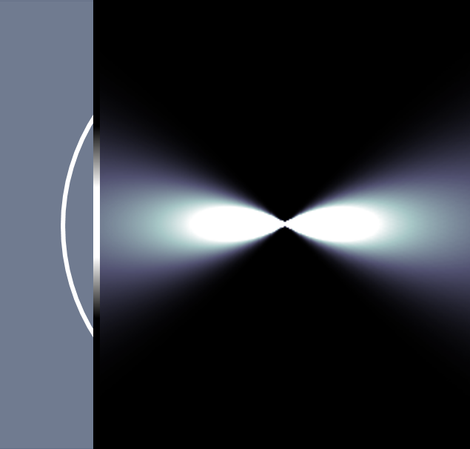
OPTICS f2f p 160

Slide 4
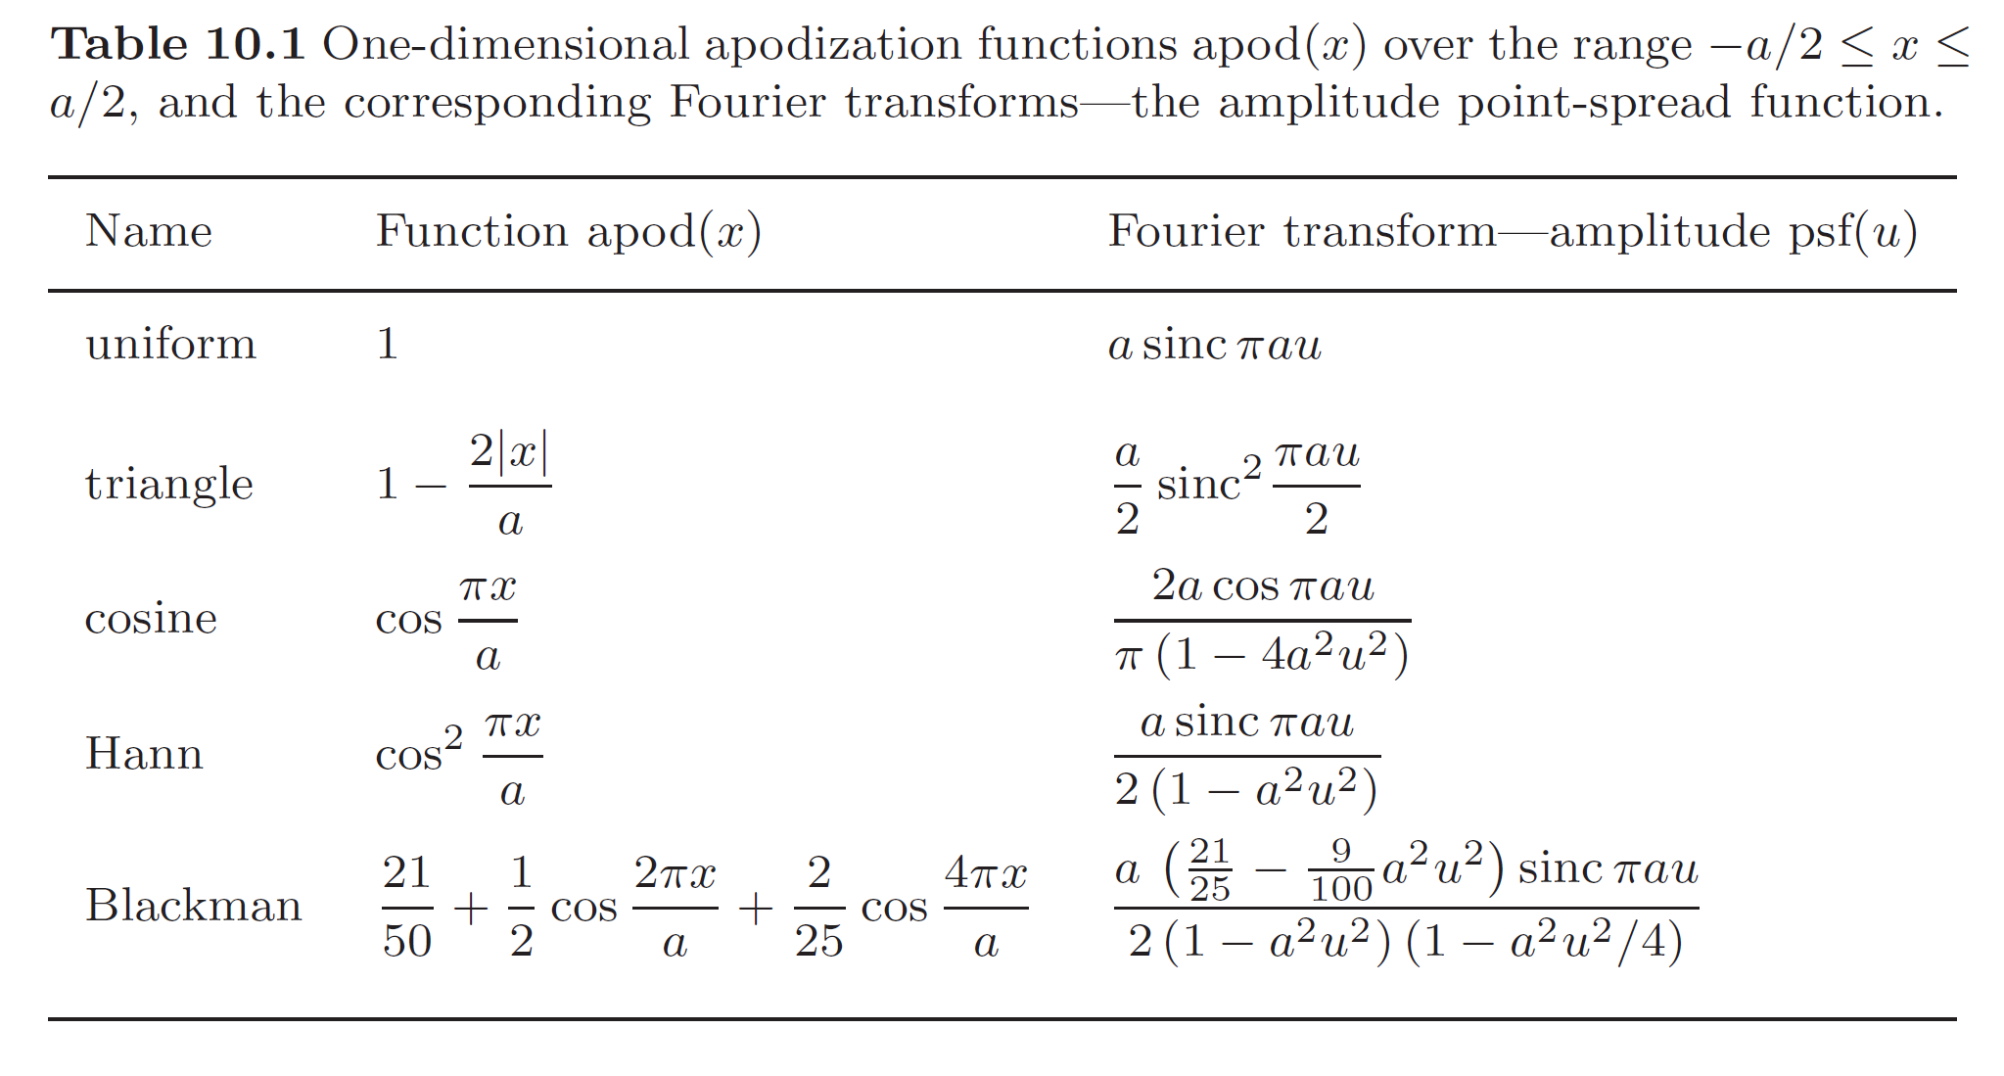
OPTICS f2f p 161

Slide 5
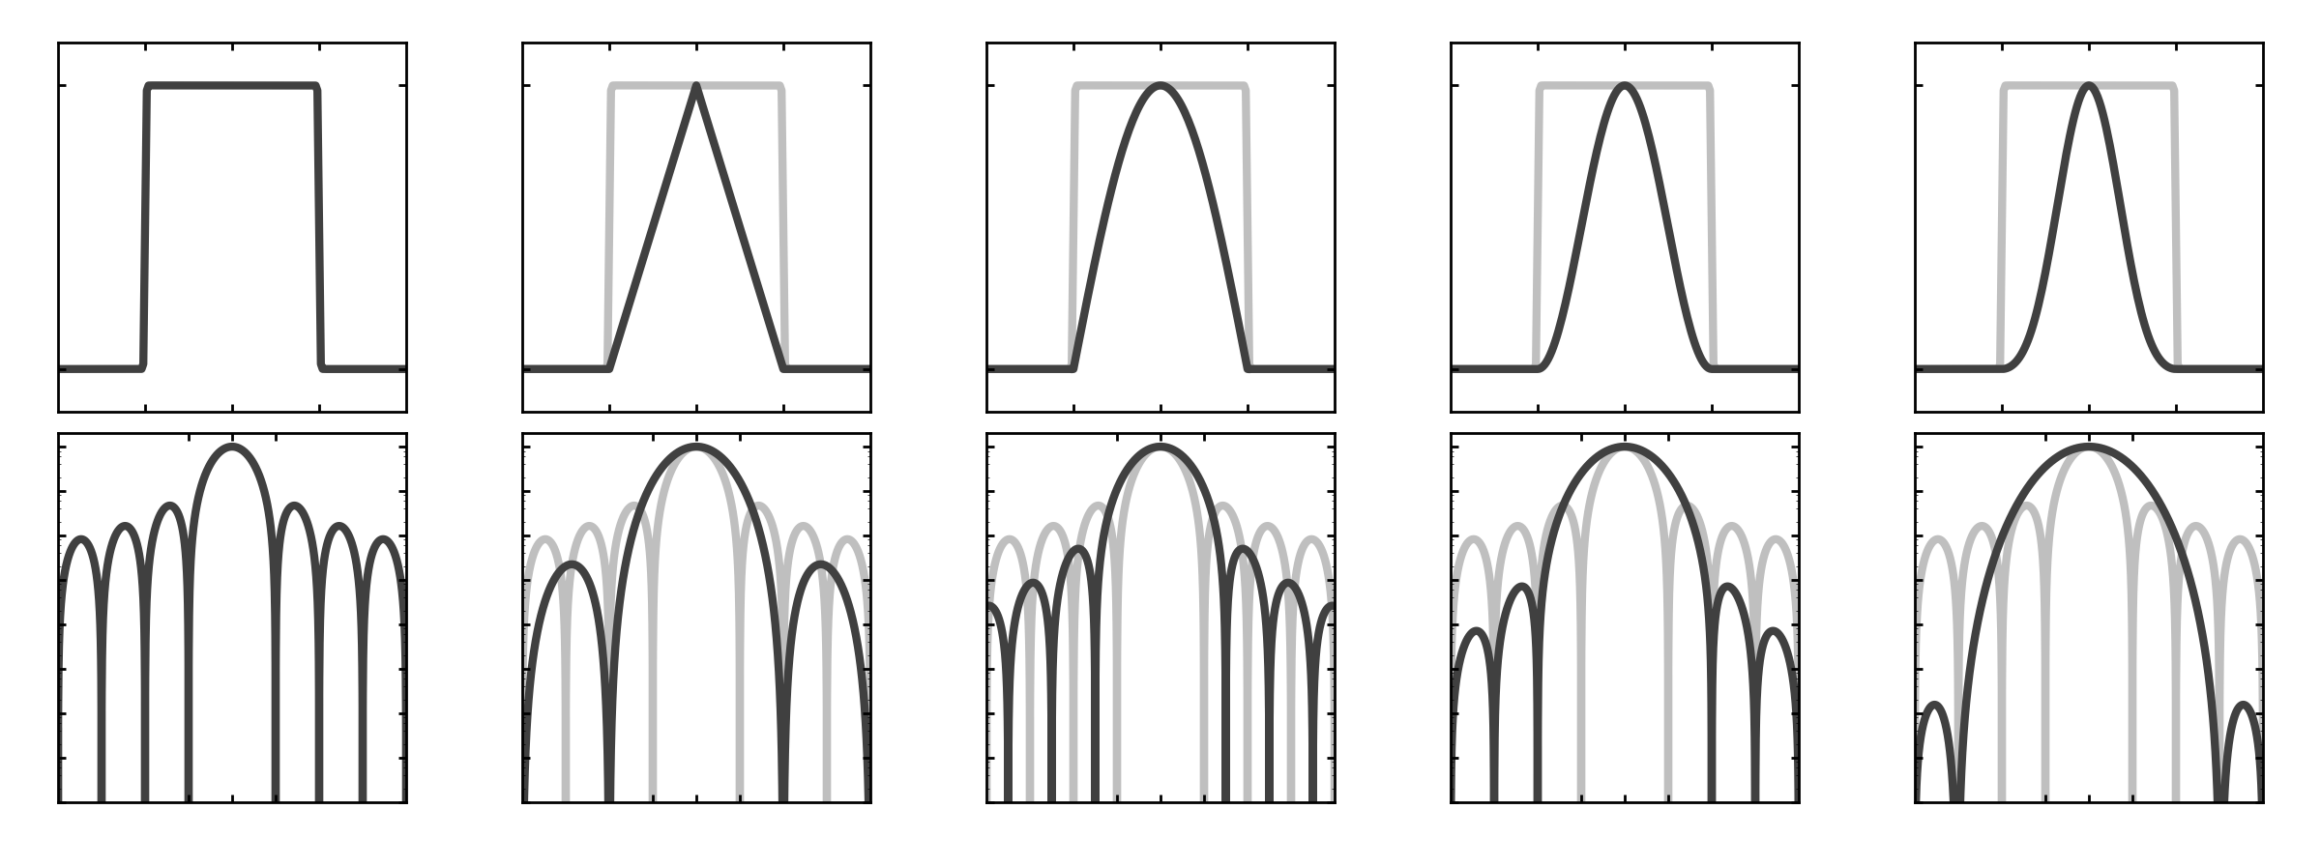
OPTICS f2f p 162

Slide 6
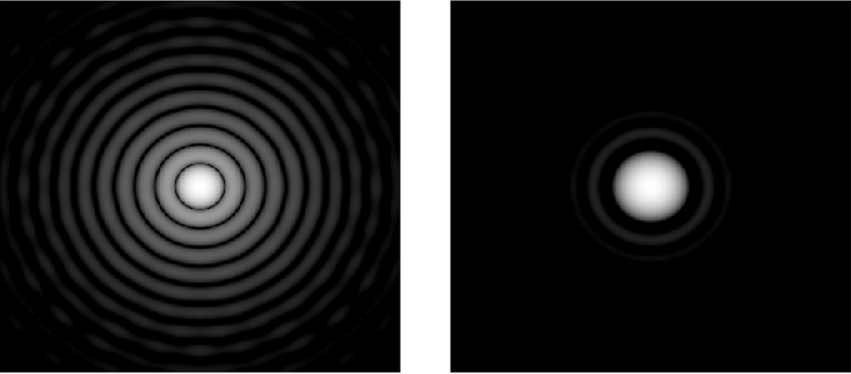
OPTICS f2f p 163

Slide 7
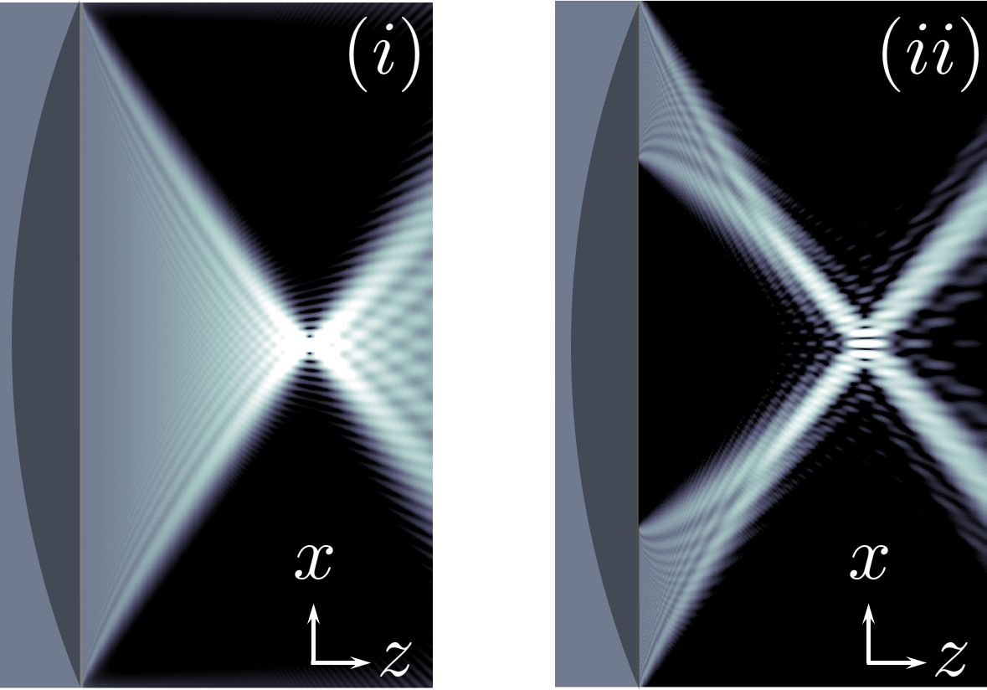
OPTICS f2f p 164

Slide 8
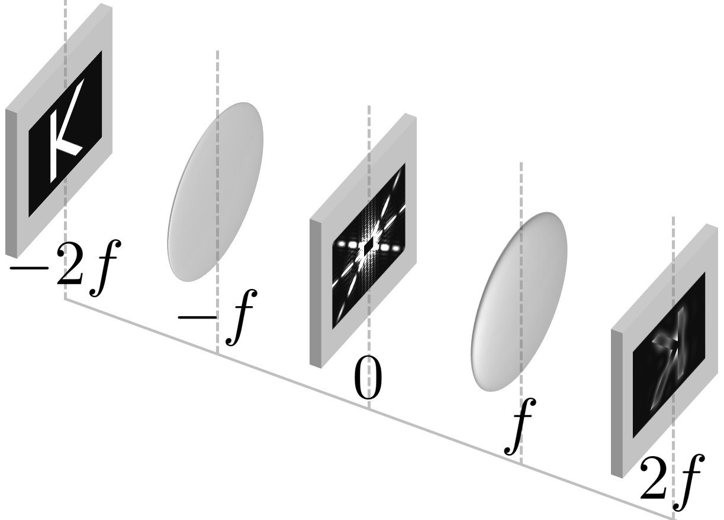
OPTICS f2f p 165

Slide 9
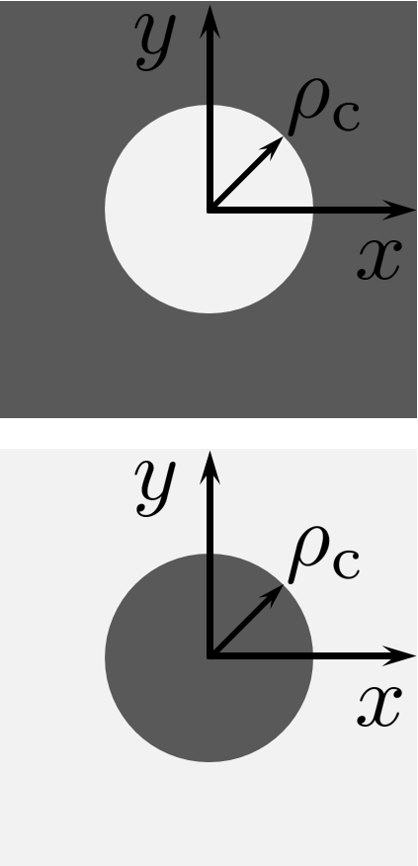
OPTICS f2f p 165

Slide 10
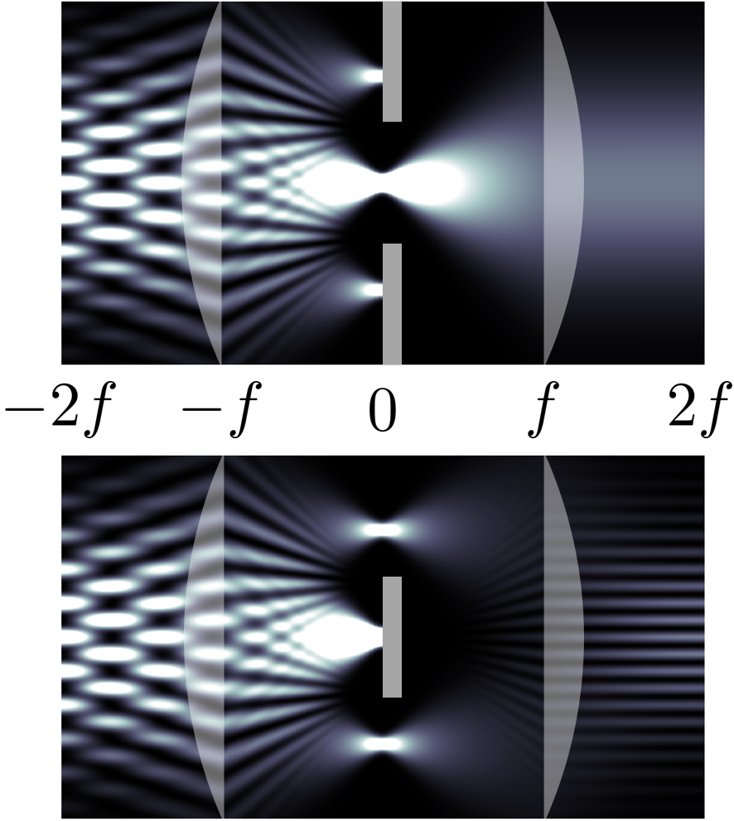
OPTICS f2f p 166

Slide 11
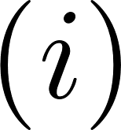
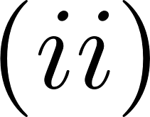
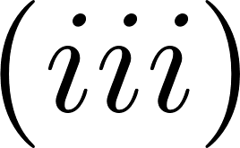
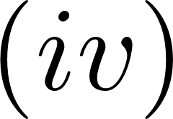
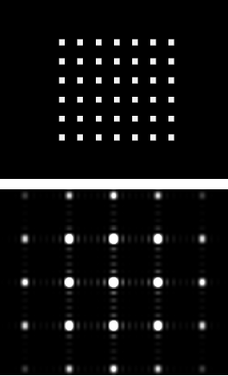
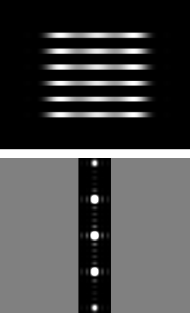
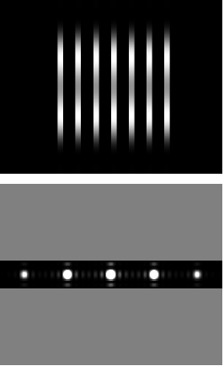
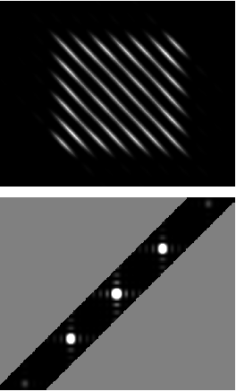
OPTICS f2f p 167

Slide 12
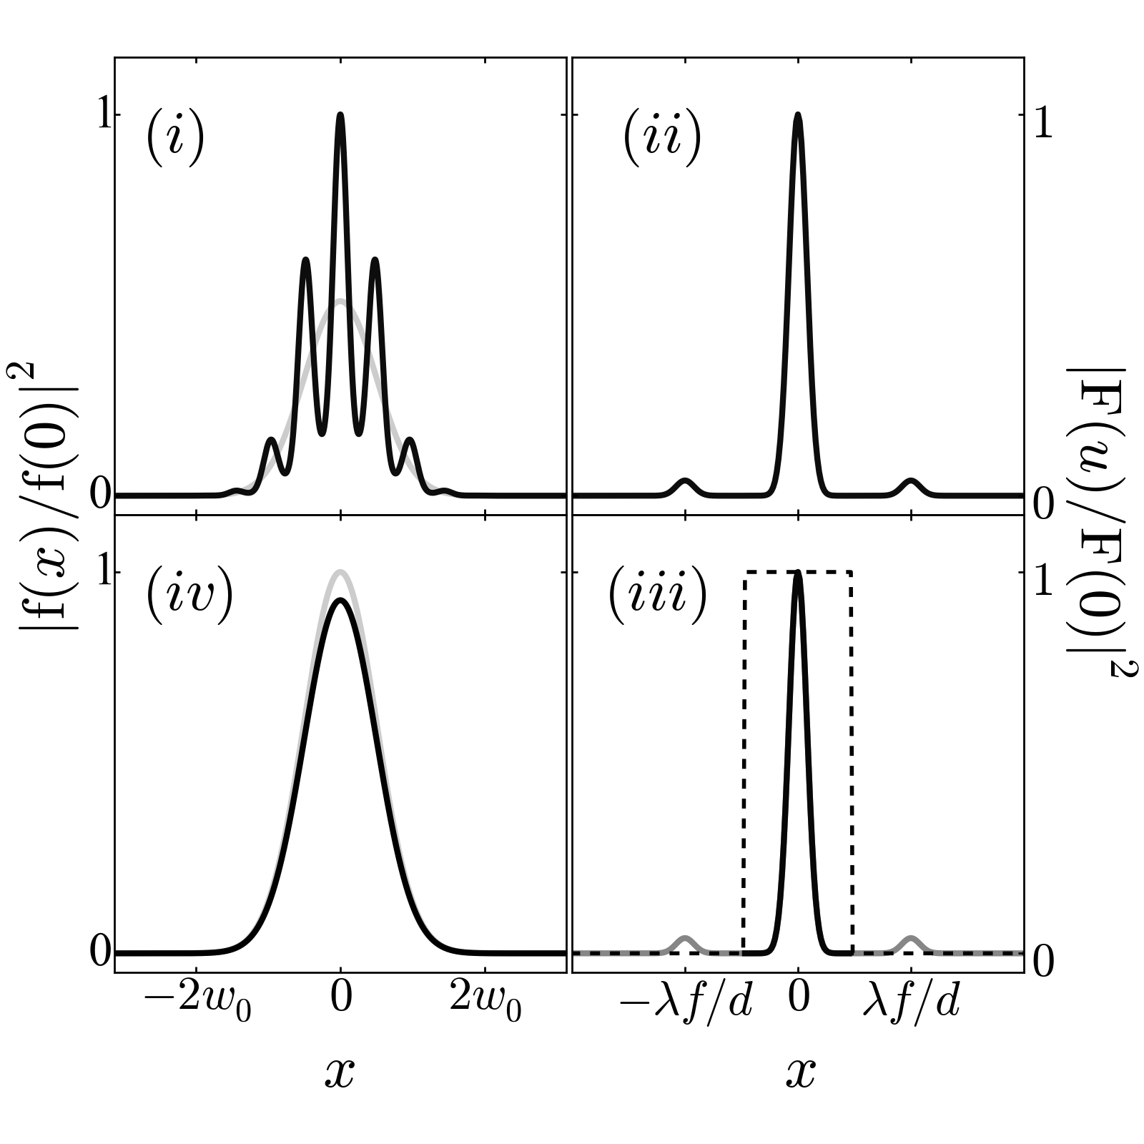
Low-pass filtering
OPTICS f2f p 168

Slide 13
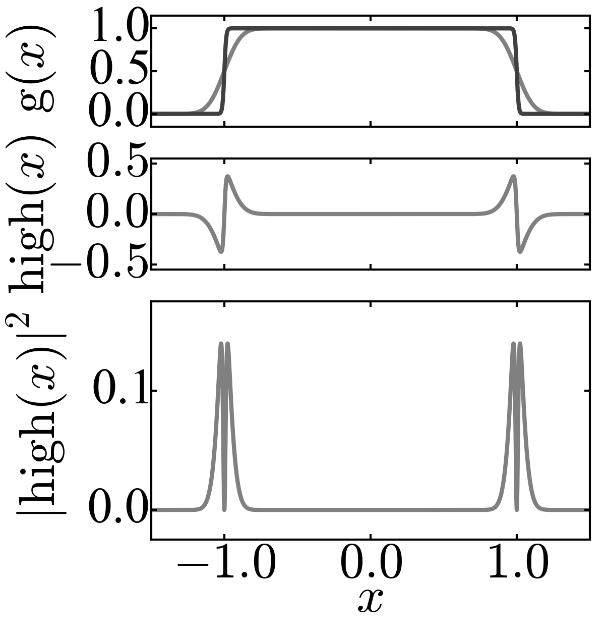
High-pass filtering
OPTICS f2f p 168

Slide 14
No filtering
Low pass
High pass
OPTICS f2f p 169

Slide 15
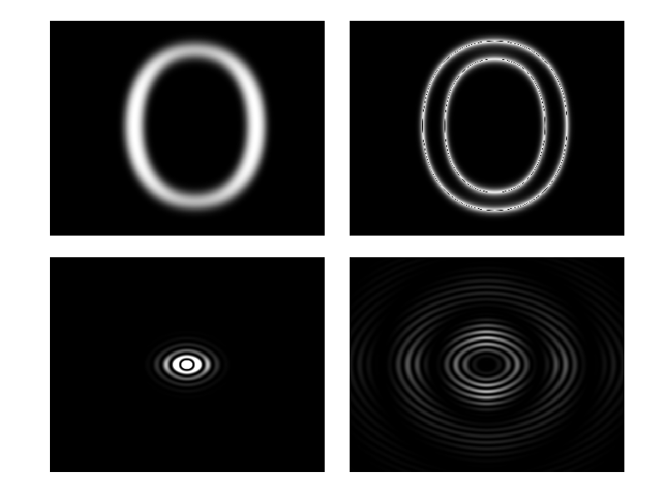
OPTICS f2f p 169

Slide 16
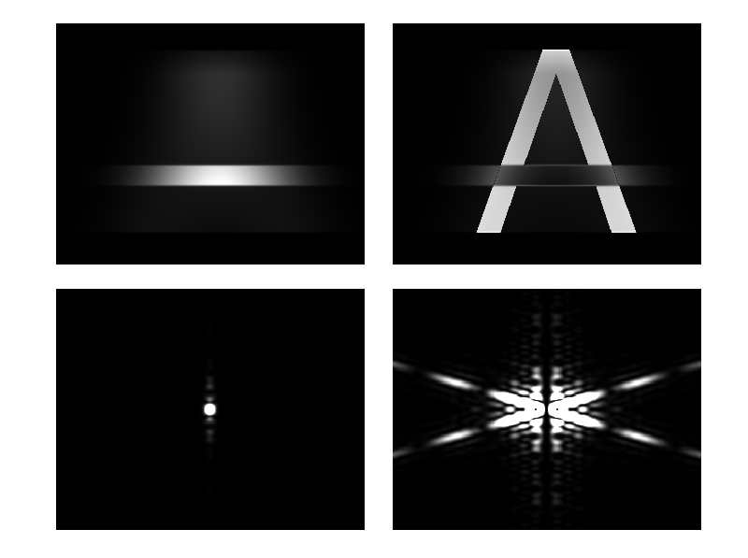
OPTICS f2f p 170

Slide 17
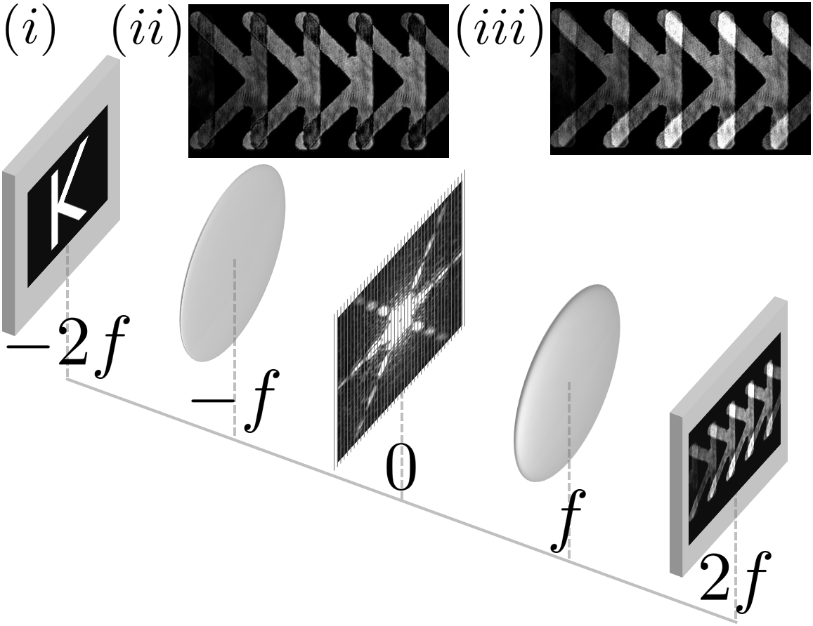
Diffraction grating as a filter - replicator
OPTICS f2f p 170

Slide 18
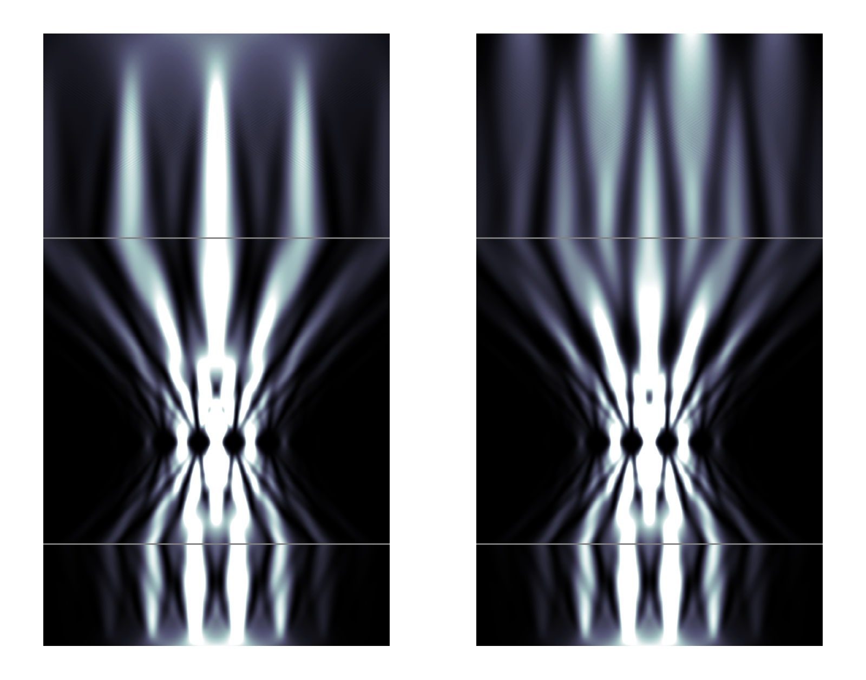
Phase-contrast imaging
OPTICS f2f p 171

Slide 19
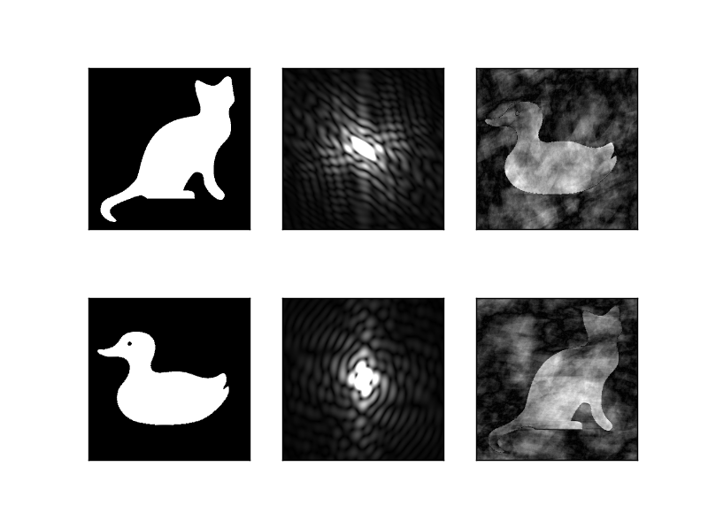
OPTICS f2f p 172

Slide 20
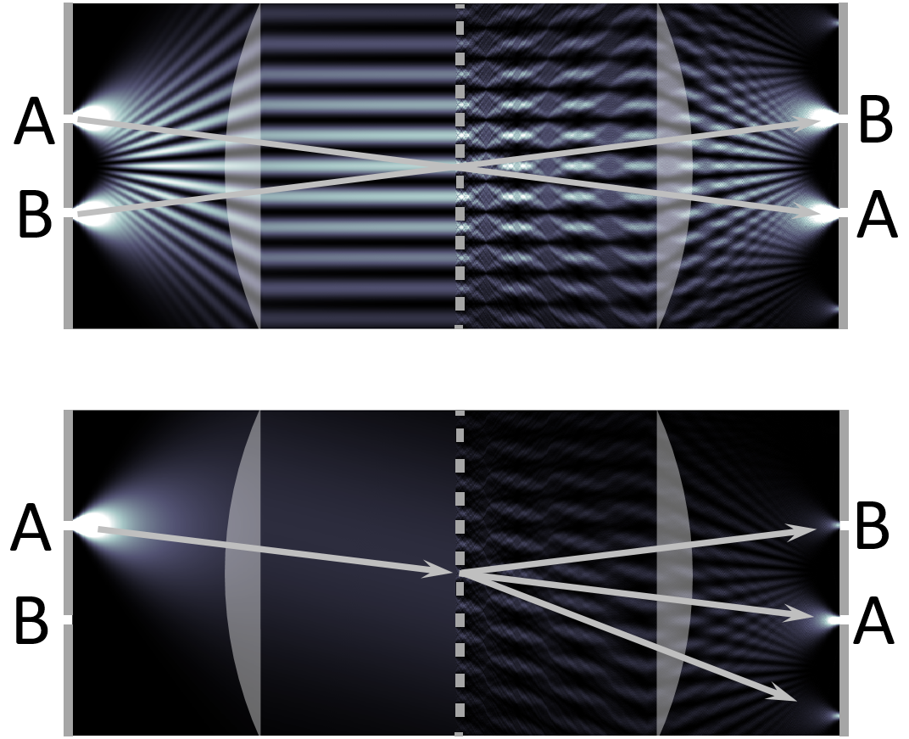
Complementarity
OPTICS f2f p 172

Slide 21
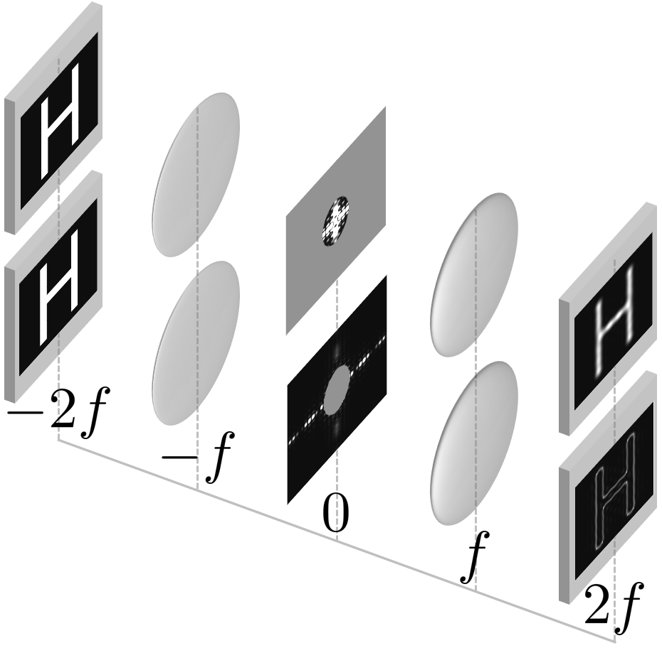
OPTICS f2f p 175

Slide 22
OPTICS f2f p 176

